Slide 1

Fundamentals of information System Security
SEC 285
Tavaughn Mason
Devry University College of Engineering and Information Sciences
Instructor: Nathan Braun
Course Number: 61660

Slide 2
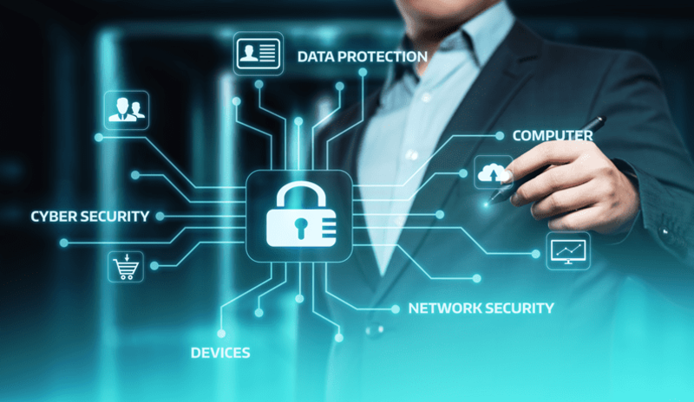
Introduction
This Course explores the Fundamentals of Information Security attacks and defense mechanisms. Security issues related to people, data, networks, and devices are surveyed to provide insight into designing security solutions and policies. Technologies and practices that support the security principles of confidentiality, integrity and availability.

Slide 3

Module 2 asymmetric Key encryption
Secure file management is implemented to mitigate risk to data assets by exploring security vulnerabilities and various best practices

Slide 4
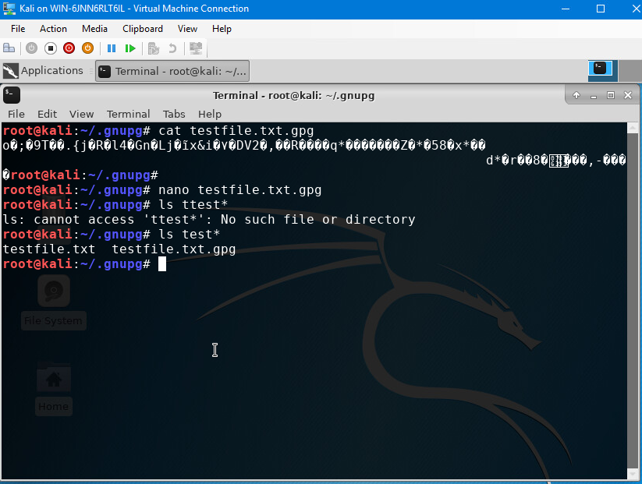
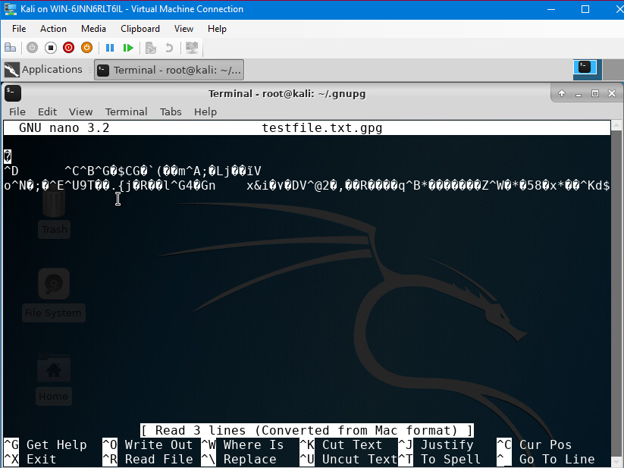
File Encrpytion
This screenshot shows the following.
Content of the plaintext file
Content of the encrypted file

Slide 5
Module 3 Stateful Fire wall
Explore how a firewall protects enterprise computing resources from attacks. Using the Linux operating system, I will demonstrate how to set up a stateful firewall using iptables.

Slide 6
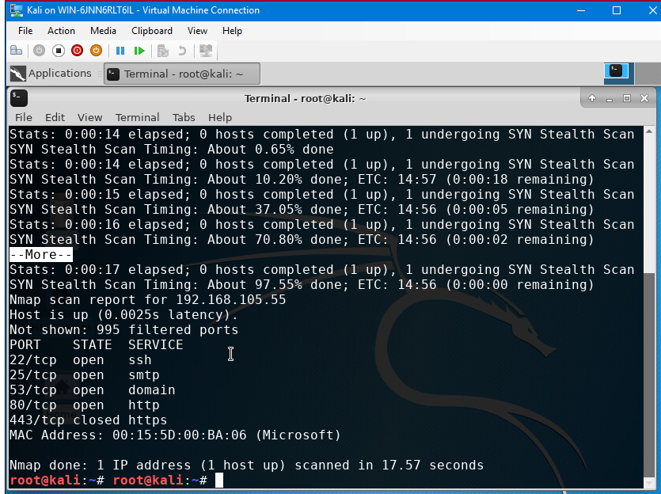
Nmap scan results
Nmap scan result of the Linux Server VM. : Policy input drop means that all incoming traffic not meeting the matching rules will be dropped. For example, if the table is set to accept, it would allow all incoming traffic so long as it doesn’t have any matching rules.

Slide 7

BYOD Security Device Policy Example
Overview:
The use of tablets and smartphones is increasing as they are becoming the mainstream source of information connected to the internet. Since Smartphones, Tablets, and Laptops are so common, we need to establish methods to isolate the hardware that is allowed to securely access our database while allowing BYOD systems to be used. These devices can connect to our servers wirelessly or physically through USB or ethernet cables. They can contain harmful software that can impede systems service delivery, for example, hardware, booting, and electromagnetic spying.

Slide 8

BYOD Security Device Policy Example Cont.
2. Purpose:
This document aims to identify potential devices that can harm the company's confidentiality and integrity of available data. Some devices that can introduce surface-level vulnerability are USB-connected devices that inject code or remain connected unattended and mobile operating systems with applications that can be acquired through different means.

Slide 9

BYOD Security Device Policy Example Cont.
3. Scope:
The scope of this policy is to focus on laptops that can connect to the wireless network and have access to both guest and company services on a public device. While notebooks are still allowed, specific programs must be installed should the hardware be used for company needs. However, more relaxed activities will be maintained for the server and guest access to monitor the information being transferred. Using a personal device on the network for guest purposes will be restricted to normal public internet parameters, not including any company confidential data networks. However, should a device require access, it must be assessed by SANS for network viability.

Slide 10

BYOD Security Device Policy Example Cont.
4. Policy:
For a laptop to comply with the network service needed with SANS, it would need to have a proper running OS, preferably Windows OS only, and its services up to date with current security protocols. All other OSs, such as IOS or Linux, will need security software implemented to the devices to guarantee system stability and monitoring capabilities as they access the company network. All devices will use a robust authentication management tool to help restrict unauthorized users with a screen lock and require a password. Devices used with company assets will have segmented storage, which will separate storage for business uses to avoid personal privacy issues and ownership concerns of personal data. It will also allow the company to delete business-only data without touching all other data. The IT department will uphold these standards and will always implement them

Slide 11
BYOD Security Device Policy Example Cont.
5. Policy Compliance:
The InfoSec team will verify compliance to this policy through various methods, including but not limited to, periodic walk-through, video monitoring, intrusion detection tools, business tool reports, internal and external audits, and feedback to the policy owner.
Employees found guilty of tampering with government information without proper access will have the hardware confiscated for examination. The severity of the offense will be judged based on the company's policy standards. Disciplinary actions could include termination of service, removal of network access, and, in severe cases, termination of employment.

Slide 12
BYOD Security Device Policy Example Cont.
6. Related Standards, Policies, and Processes:
Vulnerability is typically used to define a set of flaws or a weakness that makes the software susceptible to an attack or abuse. Preventing Vulnerabilities by assuring that newly created software does not contain flaws and problems as defined in the PCI – DSS.

Slide 13
BYOD Security Device Policy Example Cont.
7. Definitions and Terms:
Think of terms such as BYOD, mobile devices, and CIA. Define them here.
BYOD – Bring your own Device
USB – Universal serial Bus
PCI -DSS – Payment Card Industry Data Security Standard
IT – Information Technology
IOS – Iphone Operating System
OS - Operating System
Revision History:
Date of change | Responsible | Summary of change
November 2024 | SANS policy team | Updated and converted to new format

Slide 14

Multifactor Authentication
In this module, I implemented multifactor authentication (MFA) by adding a time-based one-time password (OTP) to the authentication process. Many enterprise end users use a single password to gain access to all computing resources. This is known as single sign-on (SSO). This simplifies the authentication process of an end user but also makes it easier for an attacker to compromise the process. To mitigate the risk, multifactor authentication (MFA) uses a regular password and a time-based one-time password (OTP).

Slide 15
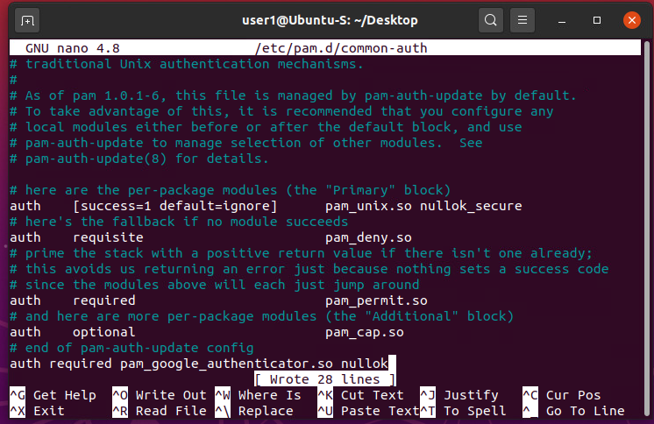
Common Auth- Configuration File
This screenshot shows the entry that indicates the use of the Google Authenticator module

Slide 16

Vulnerability Assessment
Conduct a vulnerability assessment of a server in a testing or production environment, and security practitioners use tools such as NMAP (the network mapper), Netcat, and Wireshark. You will launch these tools on the Kali VM, which are used to assess the security posture of the Linux Server VM.

Slide 17
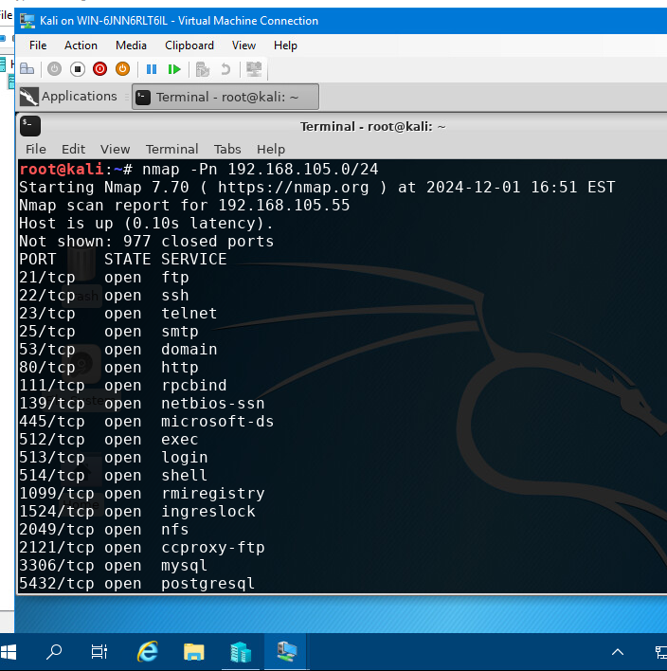
Nmap
This screenshot includes the scan result showing both the Kali and Linux Server VMs.

Slide 18
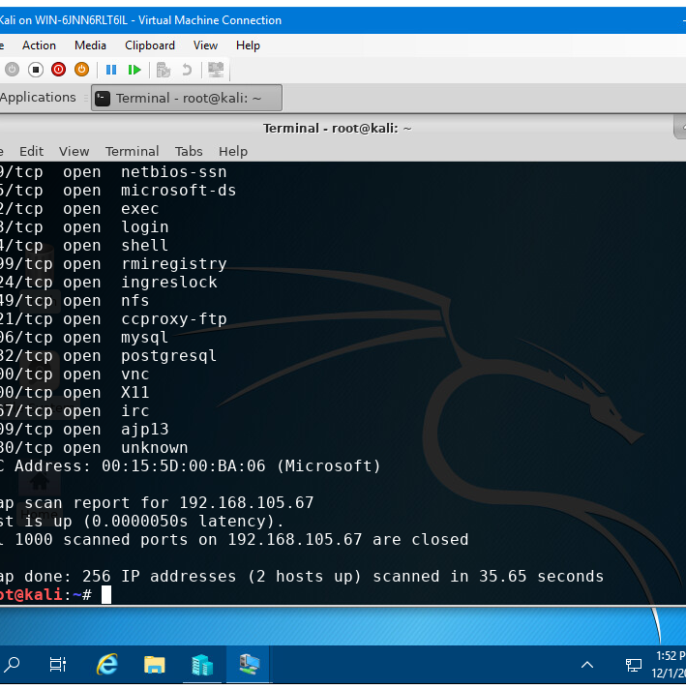
NetCat
This screenshot includes the scan result showing both the Kali and Linux Server VMs.

Slide 19
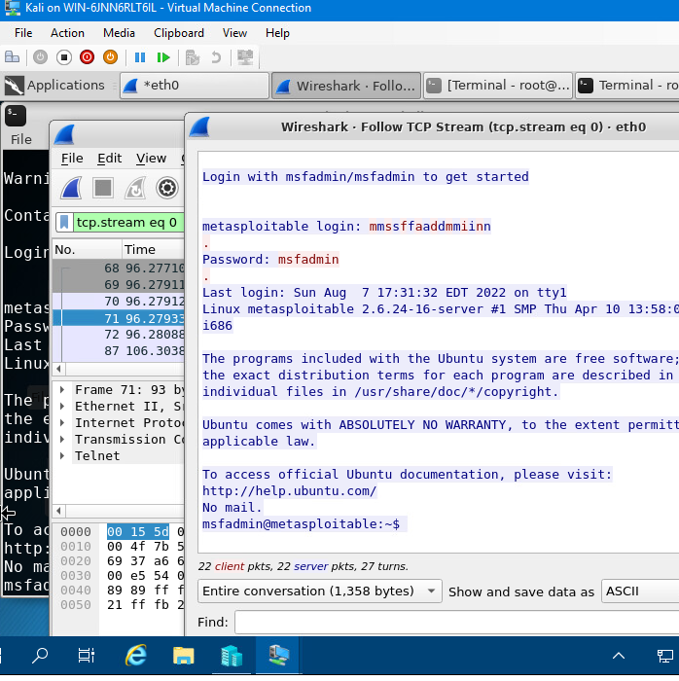
Wireshark
This screenshot should include the Wireshark—Follow TCP Steam window showing the Telnet username and password.

Slide 20
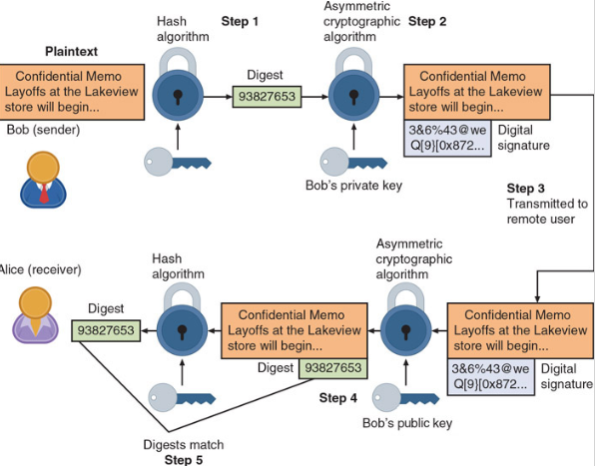
Challenges
A particular area where I found my most challenging was the course instruction with regard to asymmetric cryptography and its importance. For example, how key pairs, unlike symmetric cryptography, have only one key, and the fact that in some cases, the cryptography can be used in both directions with either a public or a private key. This was different for me because I had very little awareness of how this algorithm worked and how network security was maintained.

Slide 21
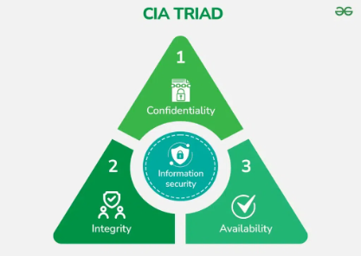
Career Skills
The carer skills I gained from this course included the ability to differentiate between different types of malware. Identifying social engineering attacks. Survey network security devices and protocols while interpreting application security and device security. And even skills and techniques to assess business continuity and risk management strategies.

Slide 22
Conclusion
During the course, I attained knowledge and awareness of the current cyber security threats from external attackers, careless employees, and accident-prone users. By adopting the new ideas put in place through this course, I can ensure that if a breach occurs, the restrictions that are in place to protect users from themselves will also prevent someone from impersonating a legitimate user and tampering with sensitive data.

Slide 23
References
Mroz, I. (2021, July 22). It’s time to distinguish information security from IT security. archTIS. https://www.archtis.com/its-time-to-distinguish-information-security-from-it-security/
Garg, R. (2024, July 12). What is information security?. GeeksforGeeks. https://www.geeksforgeeks.org/what-is-information-security/
Caimpa, M. (n.d.). Chapter 4 Advanced Cryptography and PKI. In Comptia Security + Guide to Network Security and Fundamentals (Sixth, Ser. Edition) Cengage. Retrieved 2015,.

