Slide 1

Course: CEIS 106 –
Introduction to operation systems
Student: Tavaughn Mason
Instructor: Charlotte Mckenzie
Session: 60580

Slide 2

Introduction
In this course, you will explore operating system concepts by examining Windows, Linux, mobile, and virtual-based systems. The course will also cover computing system architectures and devices and introduce basic scripting.

Slide 3

Module 2 : Navigating linux file hierarchy system

Slide 4
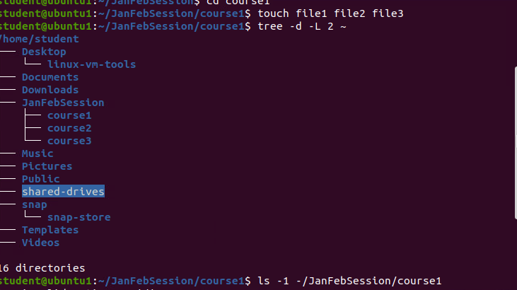
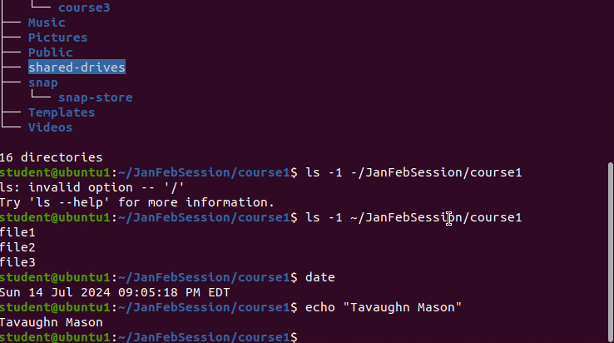
Create Directories and files

Slide 5
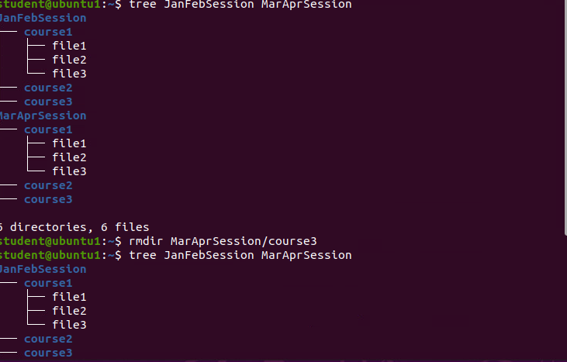
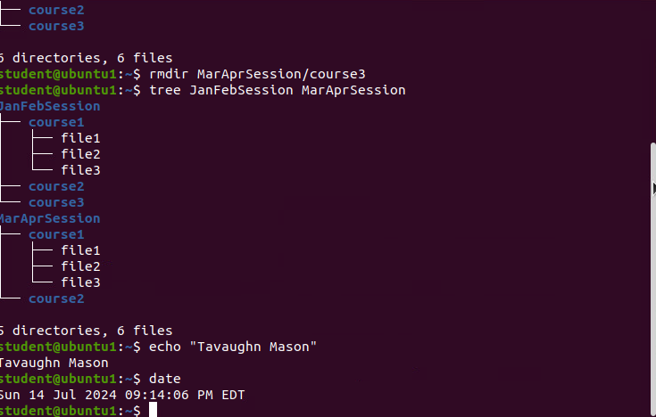
Copy and remove file system directories and files

Slide 6
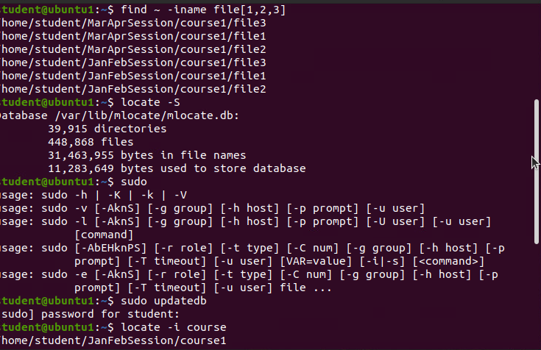
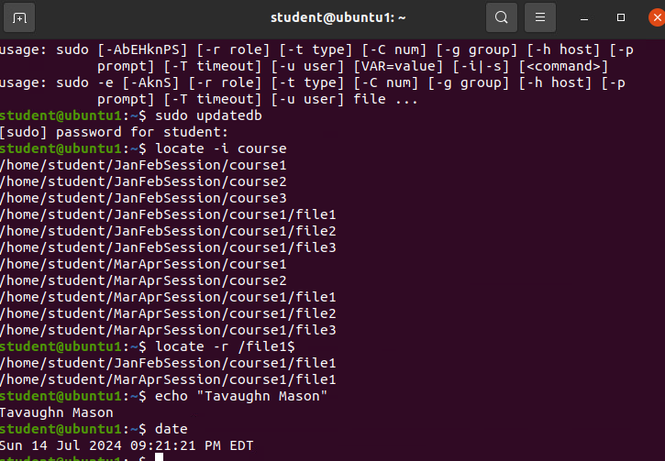
Locate directories and files

Slide 7

Module:3 Linux Shell scripts

Slide 8
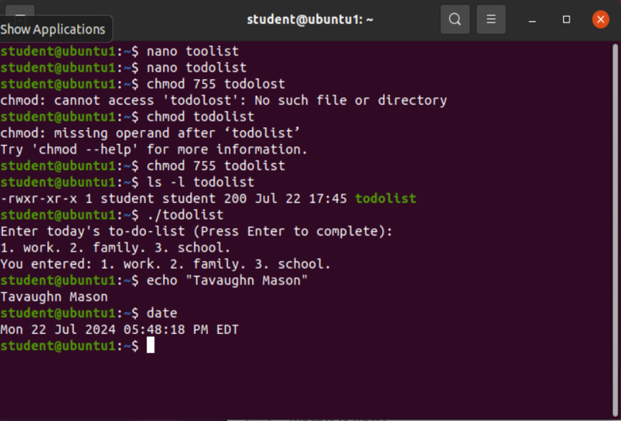
Change script file permissions

Slide 9
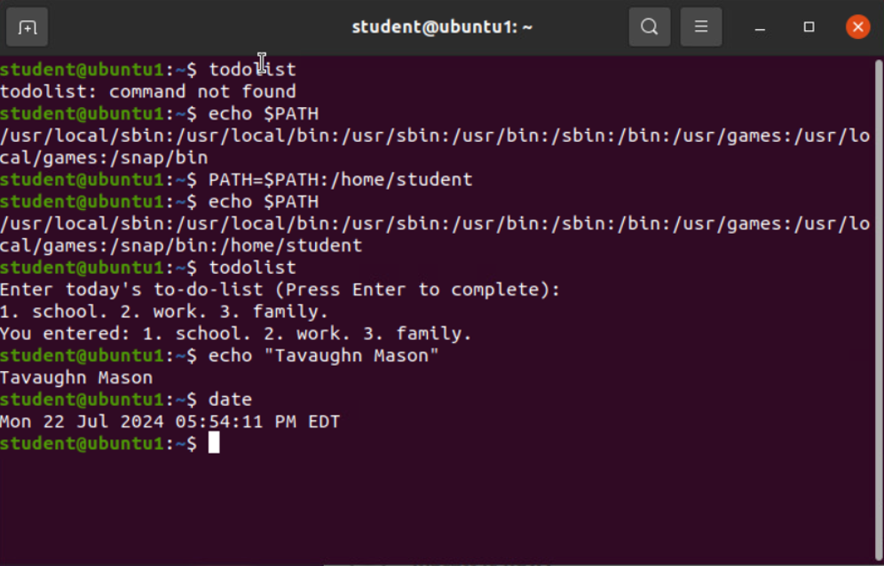
Set the path variable

Slide 10
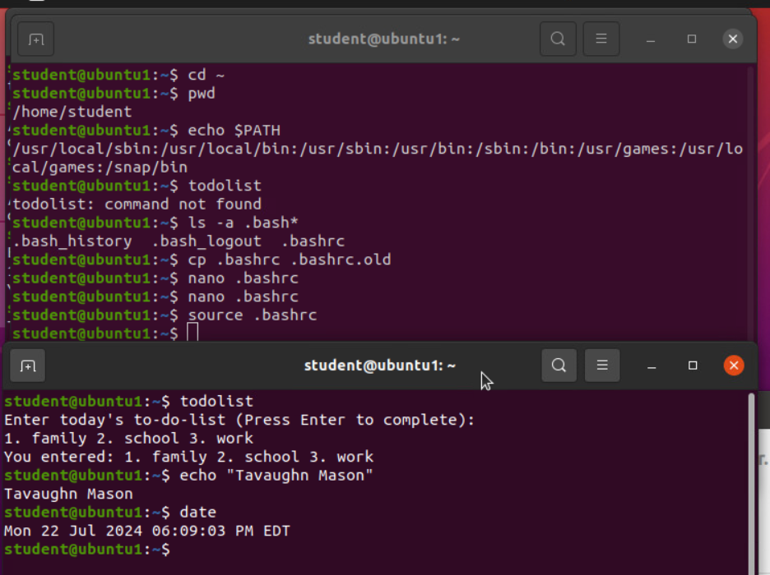
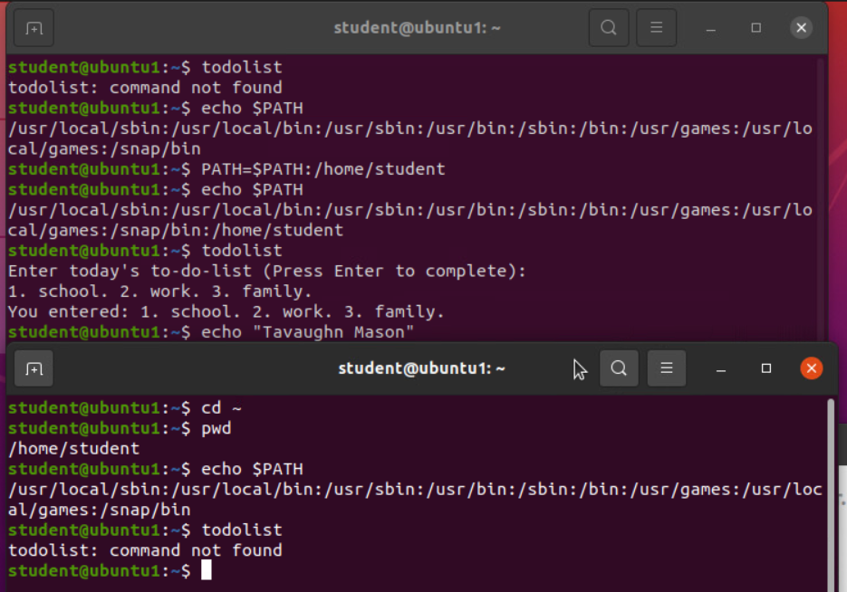
Make the PATH variable permanent

Slide 11

Module 4: Demonstrate Basic Linux Administrative task

Slide 12
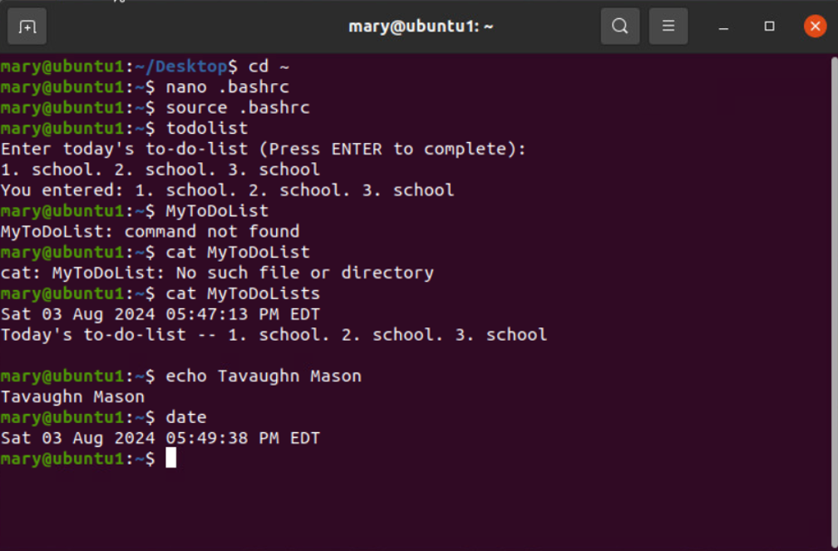
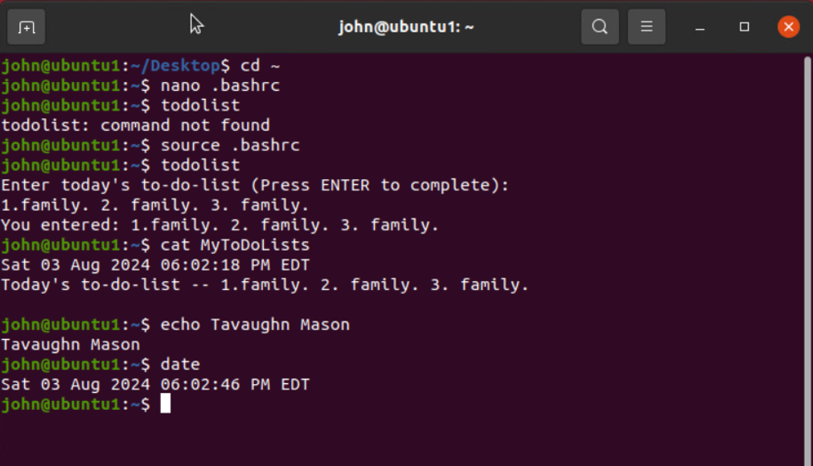
Test user and group settings

Slide 13
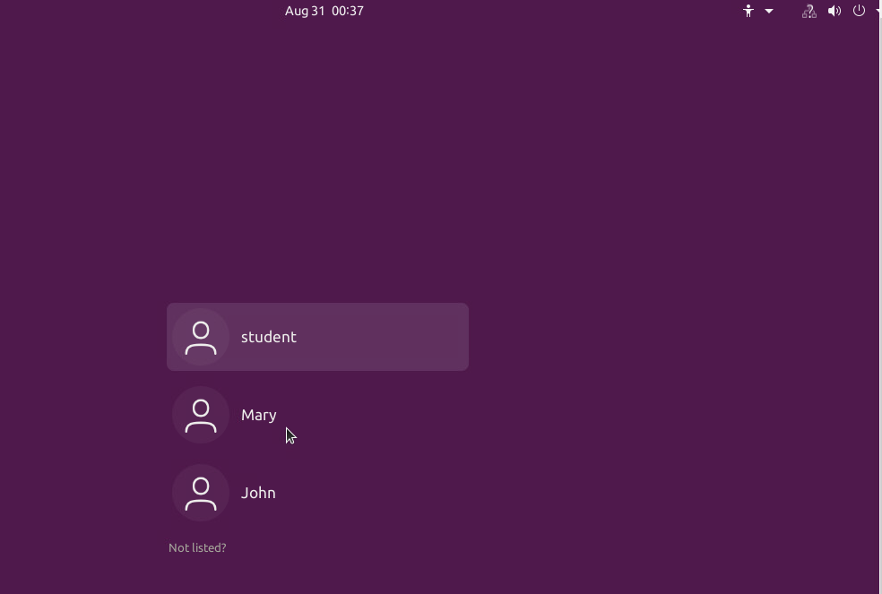
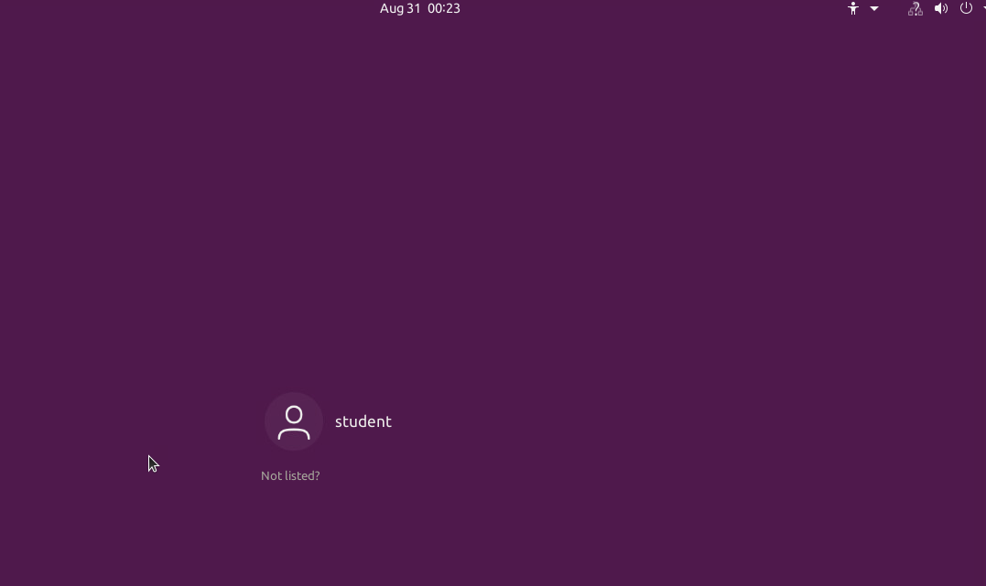
Remove users and groups

Slide 14

Module:5 Discover host and IP configurations
- Examine basic linux Network configuration

Slide 15
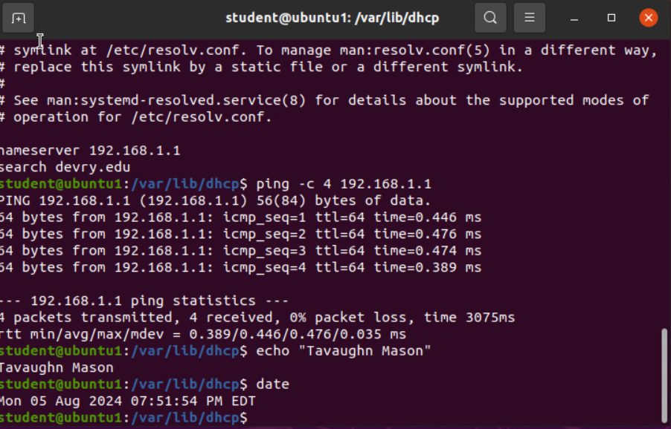
Discover IP host configurations

Slide 16
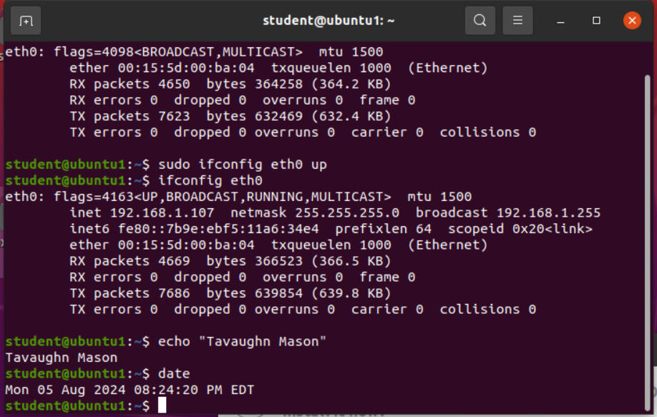
Use Network utilities

Slide 17

Module:6 Monitor Linux Process
- Identify and mitigate security risk

Slide 18
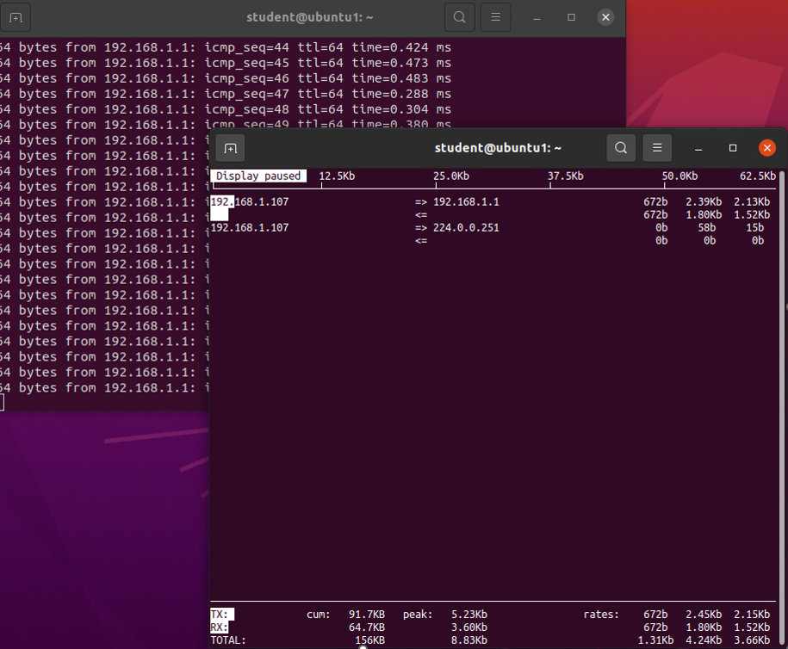
Monitor network bandwidth usage

Slide 19

Challenges-
A common challenge presented in this case was the strict detail-to-case sensitivity regarding commands given in the command prompt.
Career Skills-
The skills gained from this course are the computing and system architectures of basic scripting for the Linux operating system. This includes file system navigation, troubleshooting, and networking protocols.
Conclusion-
This course allowed me to examine Linux operating systems in relation to Windows concepts to understand their effects and security protocols better.

Slide 20

References
Dato, W. by: N. J. (2024, March 18). SIGINT and other termination signals in linux. Baeldung on Linux. https://www.baeldung.com/linux/sigint-and-other-termination-signals
What is linux tail command and how to use it. (n.d.). https://www.namehero.com/blog/what-is-linux-tail-command-and-how-to-use-it/
The Linux Foundation. (2022, September 13). Classic sysadmin: Absolute path vs relative path in Linux/unix. Linux Foundation. https://www.linuxfoundation.org/blog/blog/classic-sysadmin-absolute-path-vs-relative-path-in-linux-unix
Module 3 Lesson 1 L3_Redirection_v2. (n.d.). https://lms.devry.edu/lms/CourseExport/manual/interactives/DVU/L3_Redirection_v2/story_html5.html

