Slide 1
ECT315
Final Project Material and Due date
Student Name: Tavaughn Mason
Session: ECT315 Industrial IOT
Instructor: William Golden

Slide 2
Module 1: Introduction to Tinkercad
Tinkercad is used for rapid prototyping, a process that lets us quickly build and modify components to test different options for a project or product. We will use this prototyping method to learn how to create simple electronic circuits for the Industrial Internet of Things (IIoT) ecosystem.

Slide 3
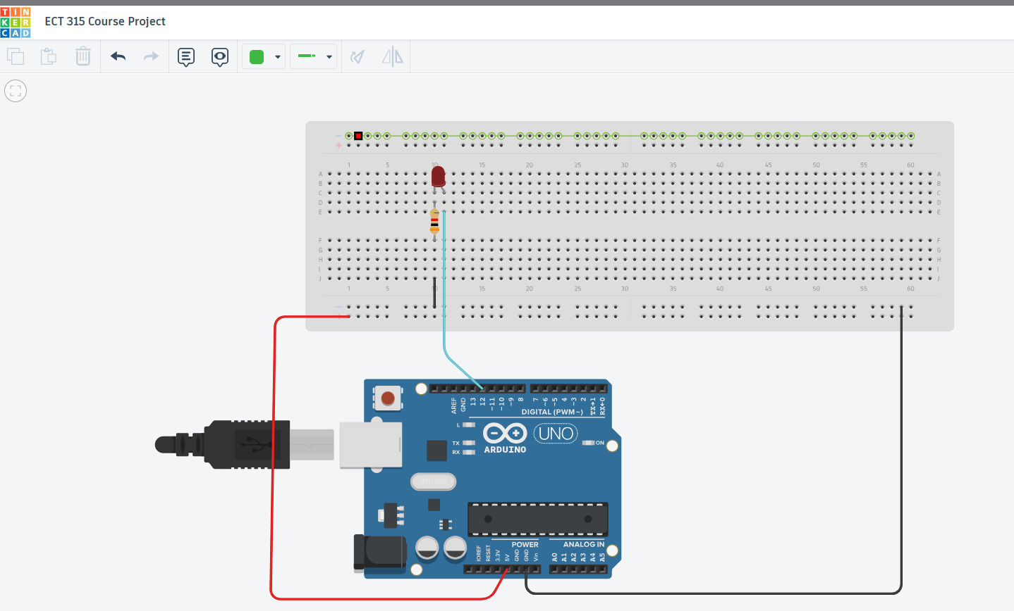
Exploring TinkerCad and a picture of a base circuit using an LED and Arduino

Slide 4
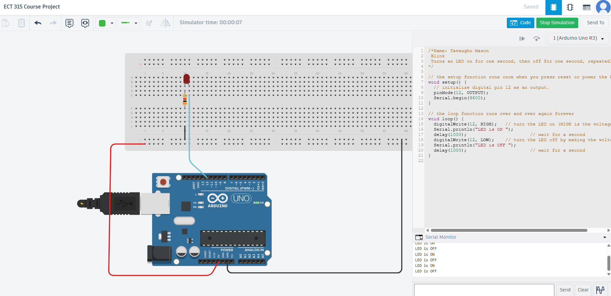
A picture of the running circuit with the LED on and serial monitor

Slide 5
Module 2: Setting up Thingspeak Environment
ThingSpeak enables real-time data visualization from connected devices and supports MATLAB® code execution for online data analysis and processing. It is commonly used for prototyping and developing proof-of-concept IoT systems that require advanced analytics.

Slide 6
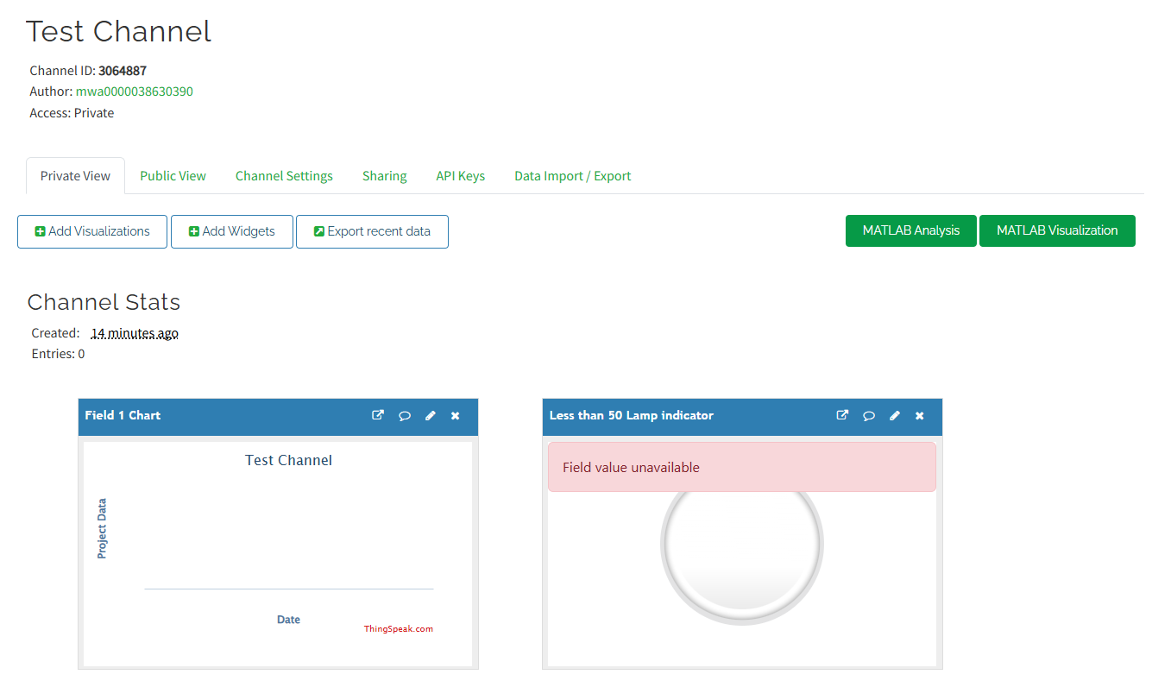
A picture of the ThingSpeak Dashboard

Slide 7
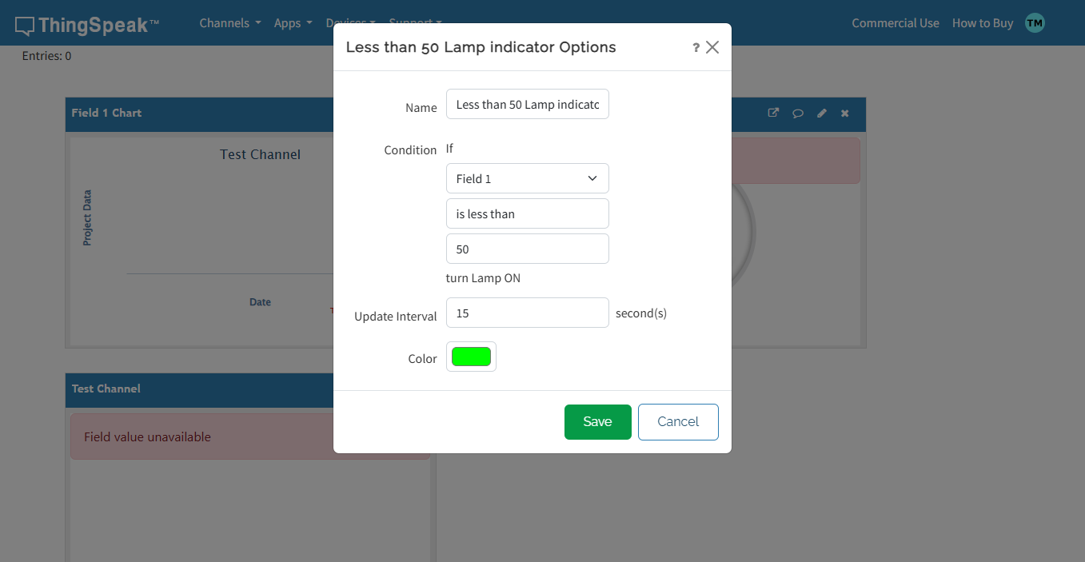
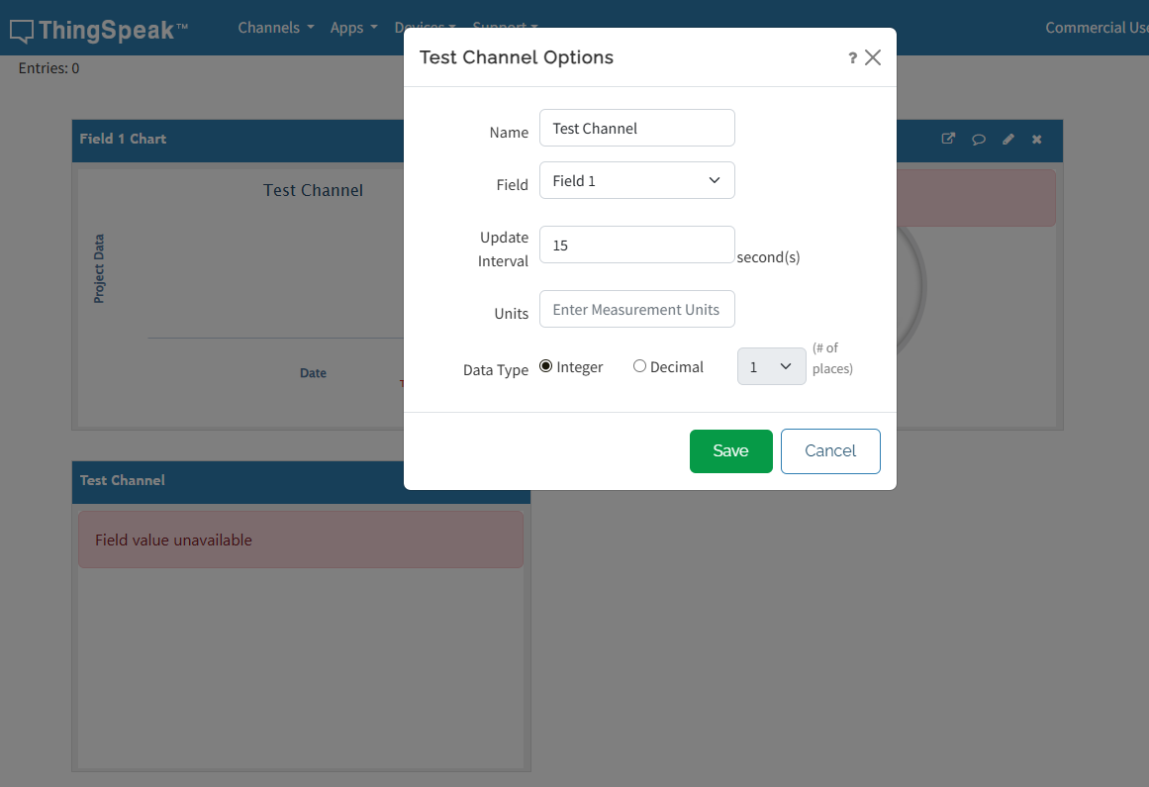
A picture of the widget lamp and a numerical Counter

Slide 8
Module 3(4): IOT Flood Monitoring system
This project is divided into two parts. Part 1 involves designing a Flood Monitoring System using Tinkercad to collect data, triggering a red light during a flood and a green light when no flood is detected. In Part 2, MATLAB will be used to process the data collected from Part 1 and transmit it to ThingSpeak for global access, monitoring, and analysis. ThingSpeak will also enable data visualization, analysis, and trigger alerts for flood warnings.

Slide 9
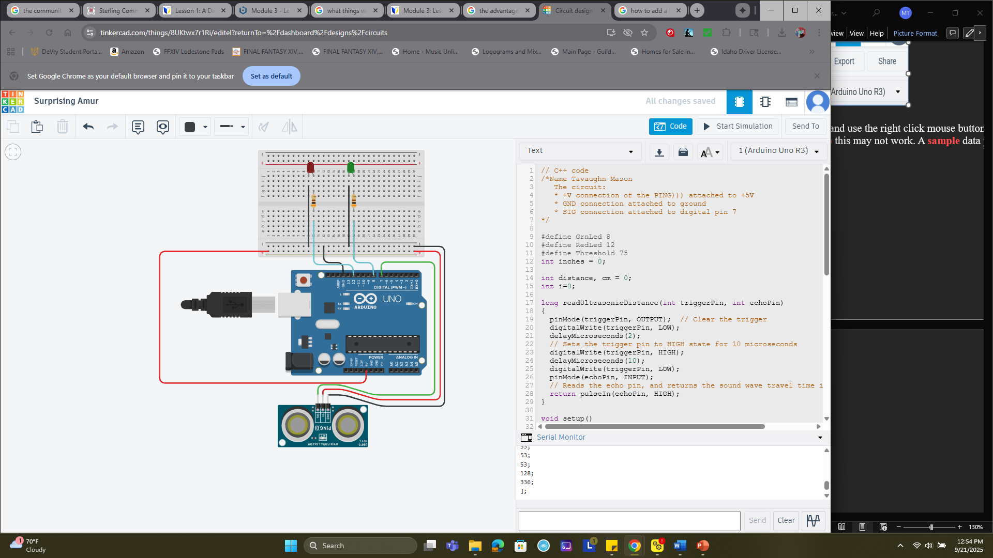
A picture of the circuit and with the code used to similate the assessment

Slide 10
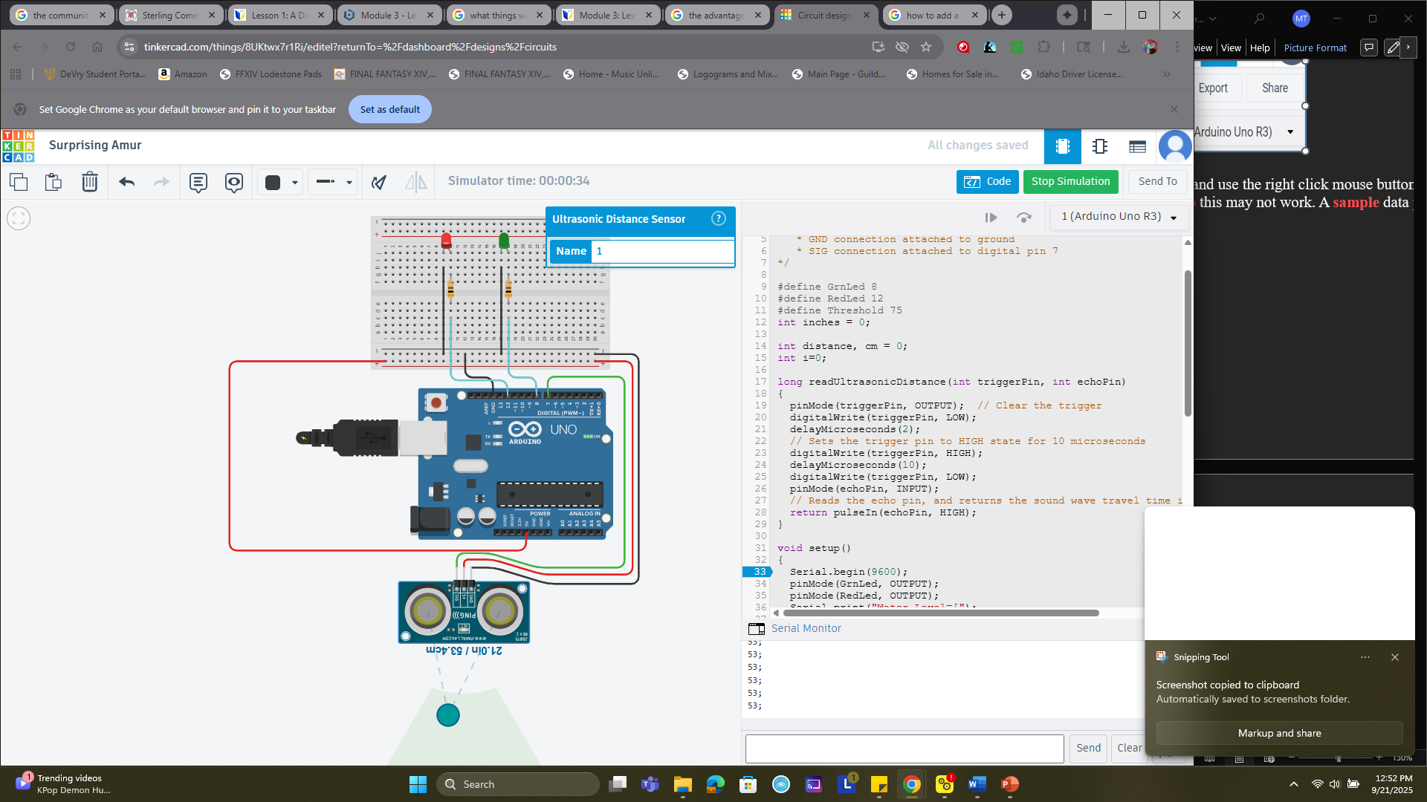
A picture with both the Green and Red Led On signaling that a flood has occured

Slide 11
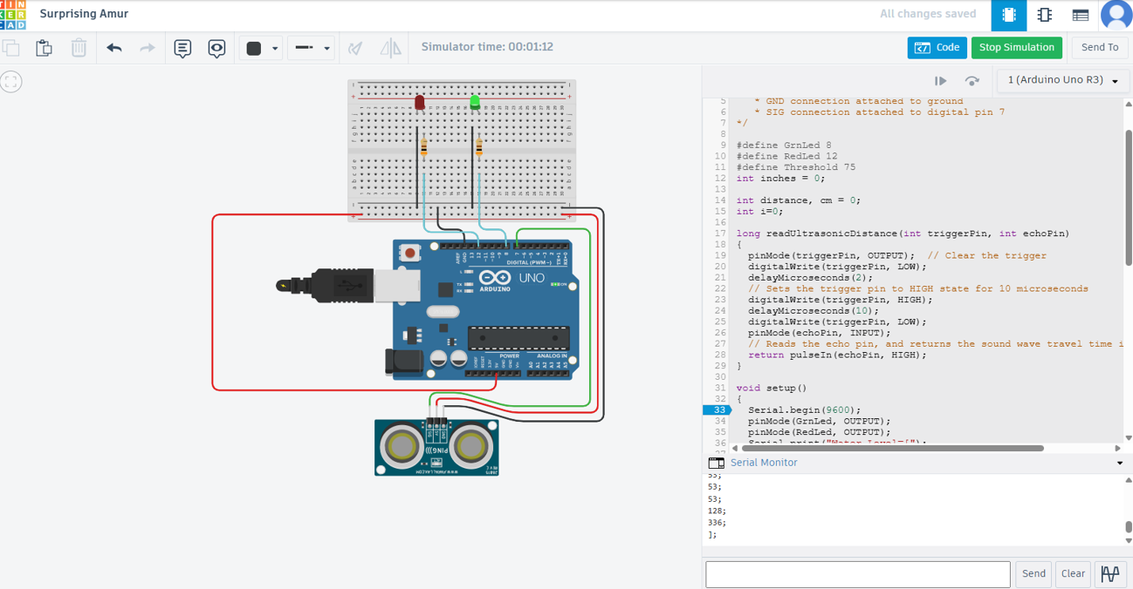
A picture with the green LED on and the Red LED off signaling that the water has been filled without overflowing

Slide 12
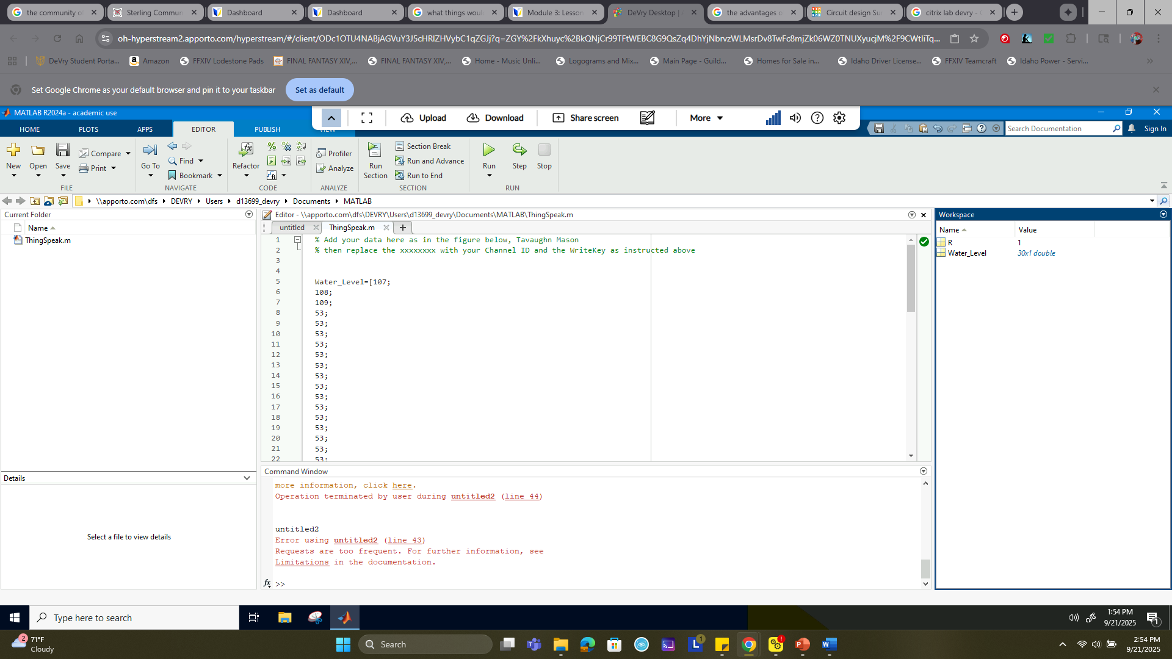
A picture with MATLAB with the collected data plots

Slide 13
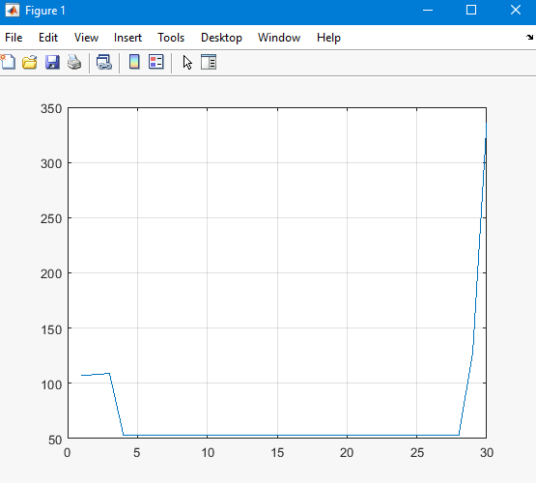
MATLAB plot generated

Slide 14
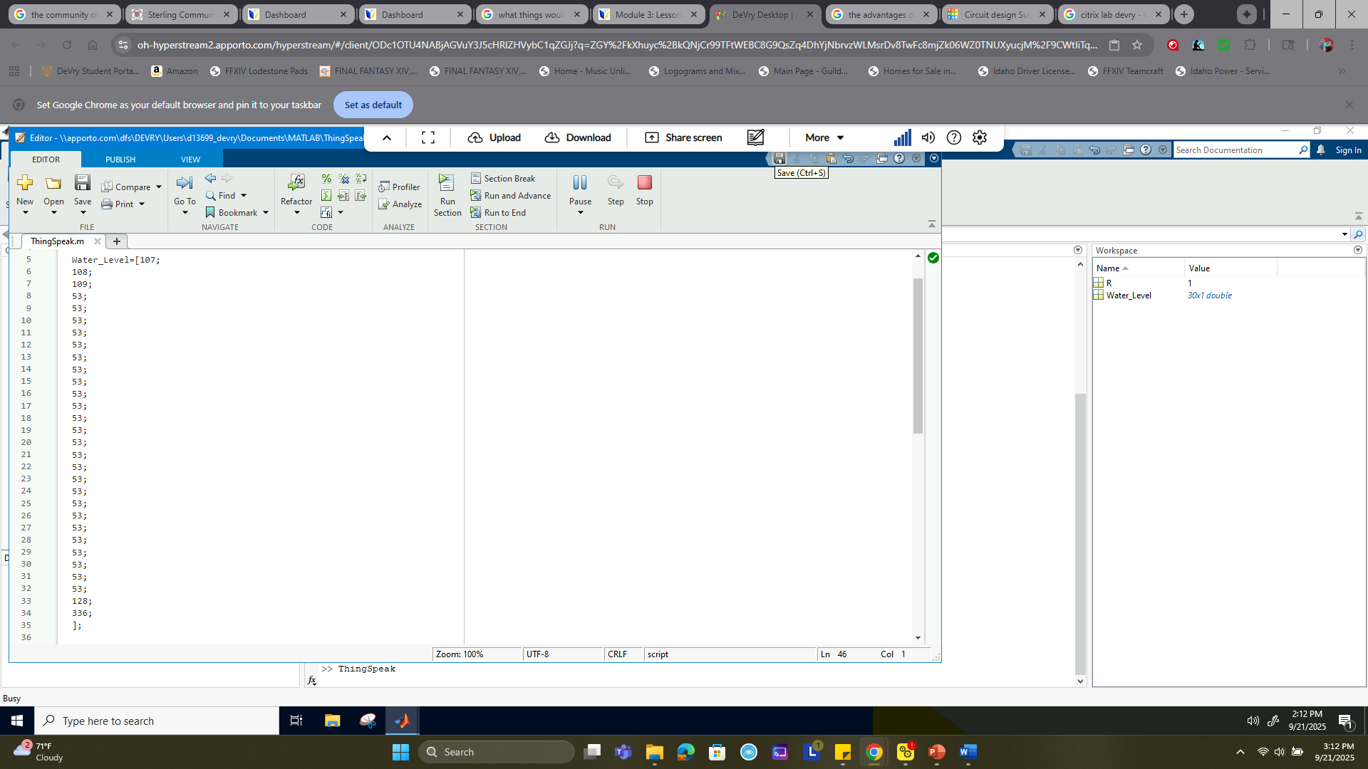
A picture of TinkerCAD data assigned to MATLAB

Slide 15
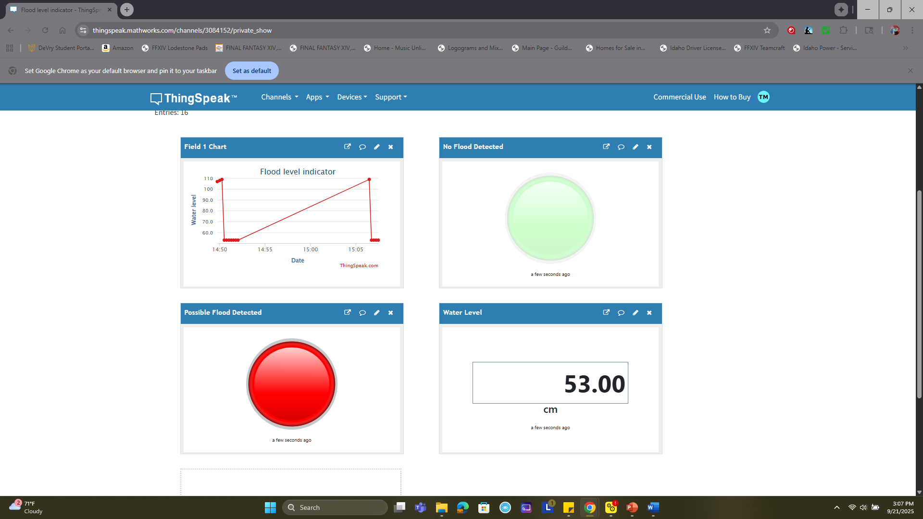
A picture of Thingspeak dashboard with the RED showing a flood warning

Slide 16
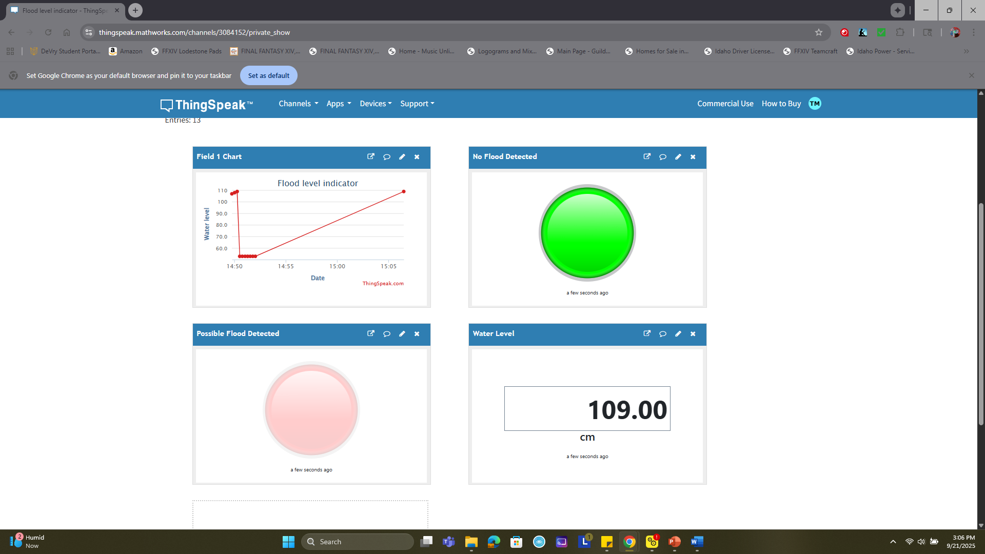
A picture of ThingSpeak and the Collected data over a network showing no flood currently exist with a Greed LED

Slide 17
Module 5: Factory Access Control System
Design and Implement a Keypad-Based Password Entry System for Secure User Authentication, Allowing Customizable Password Length, User Input, and Verification Against a Stored Password to Grant or Deny Access

Slide 18
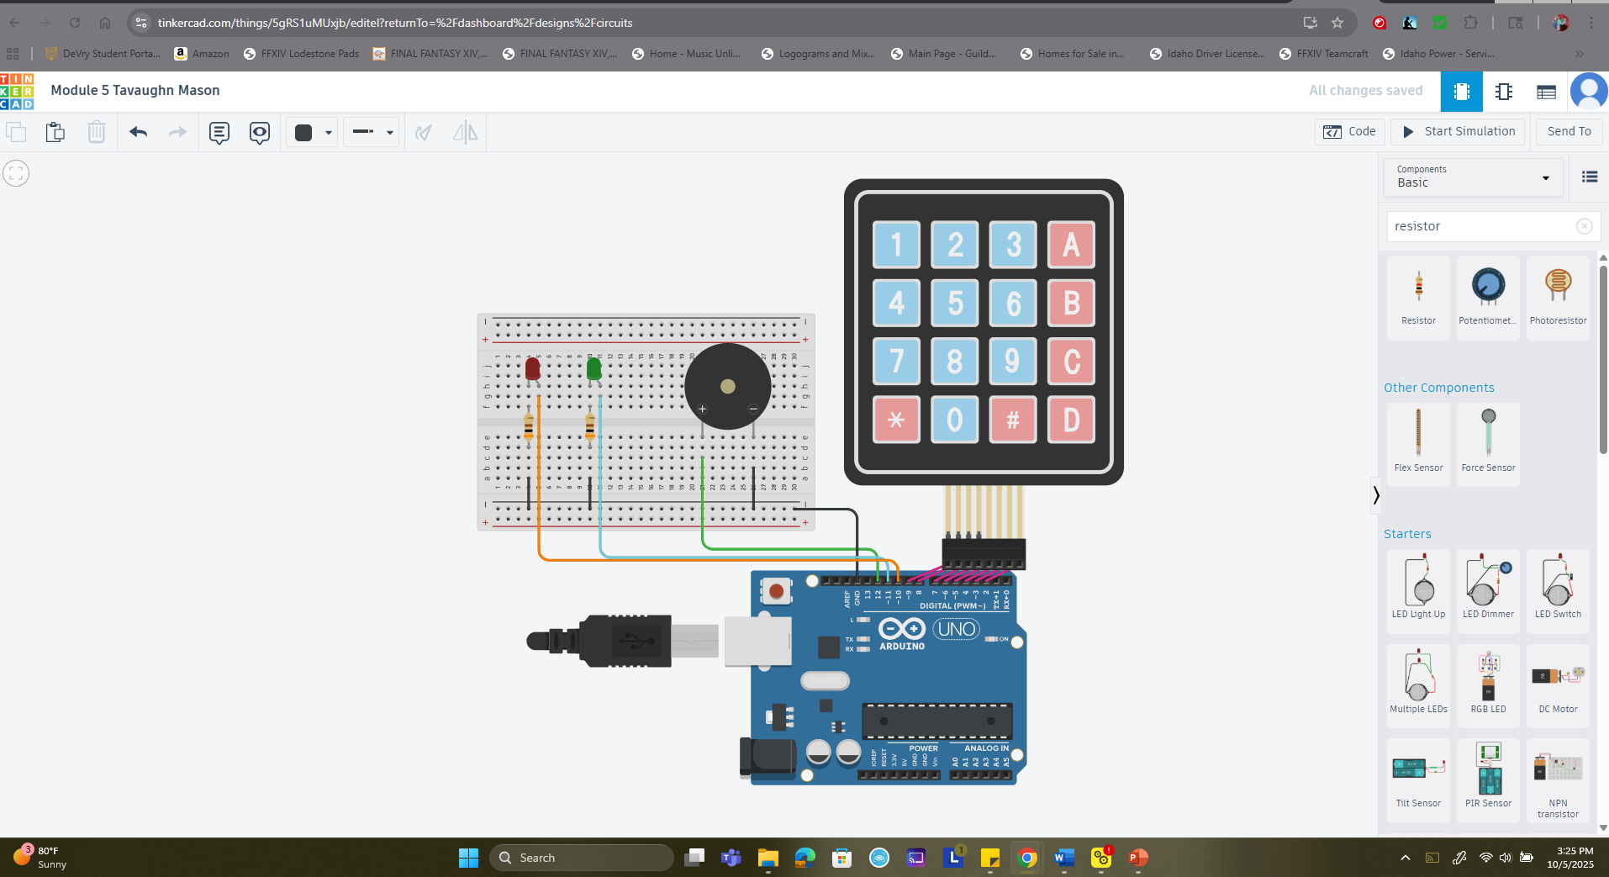
A picture of the completed circuit with keypad

Slide 19
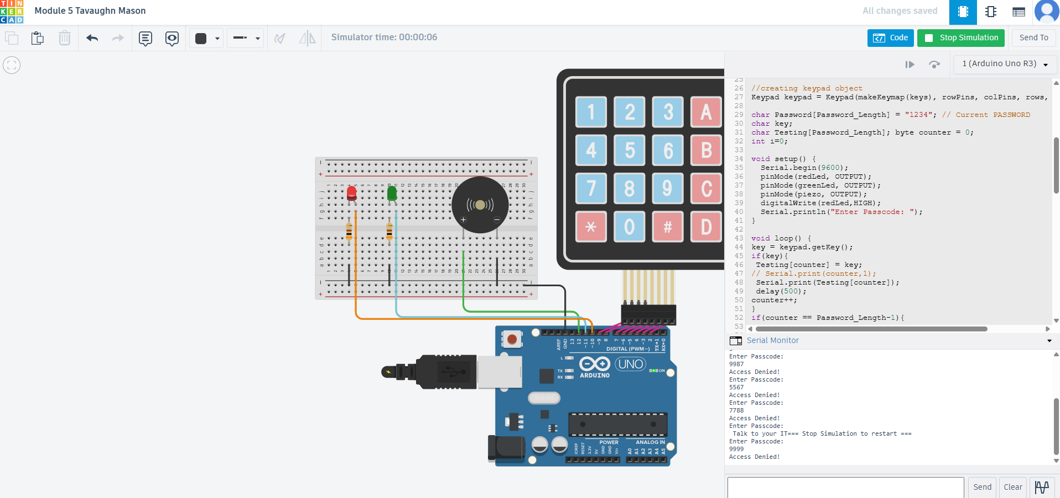
Picture of red Led on showing access is denied when the wrong password is input

Slide 20
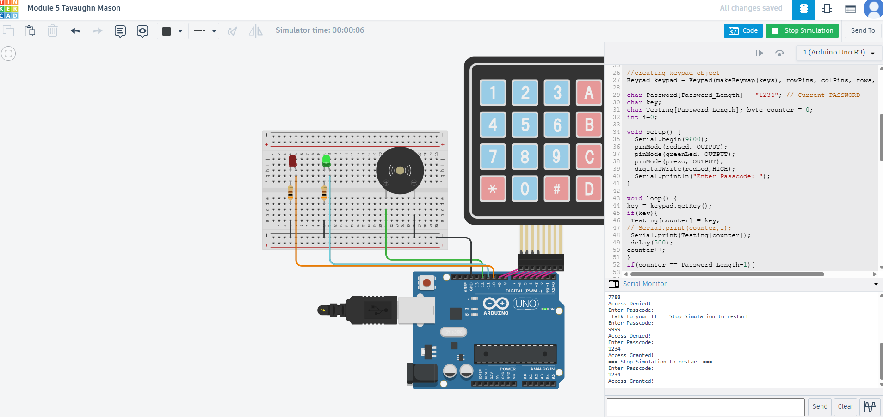
Screenshot of access granted with green LED on and serial monitor

Slide 21
Module 6: IOT environmental Monitoring system
This IoT system monitors temperature and gas sensors in real time, displaying data locally and online via MATLAB and the ThingSpeak IoT platform. It uses an LED to indicate temperature levels and an alarm to detect smoke levels.

Slide 22
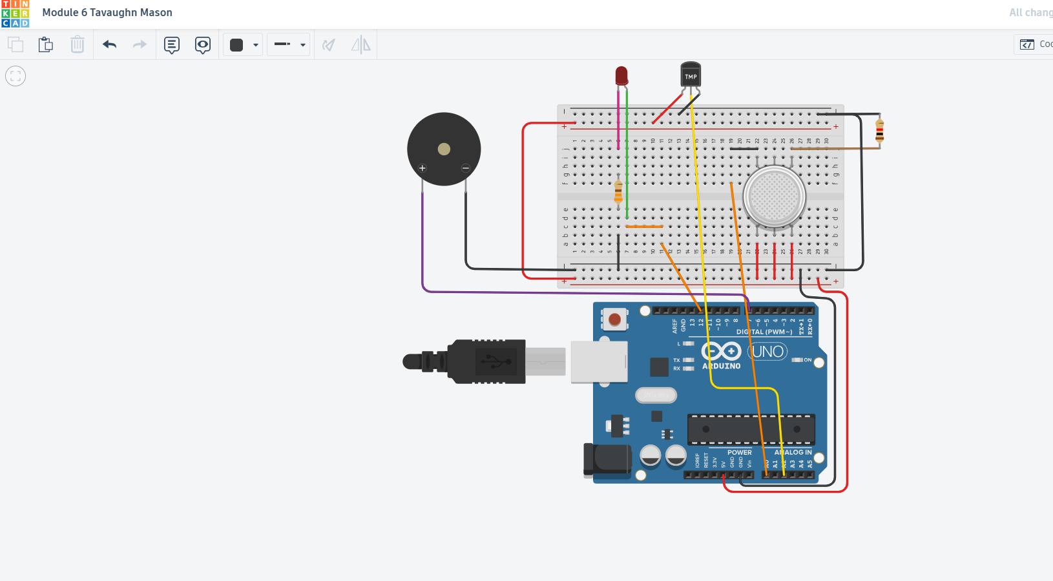
A screenshot of the completed circuit in Tinkercad

Slide 23
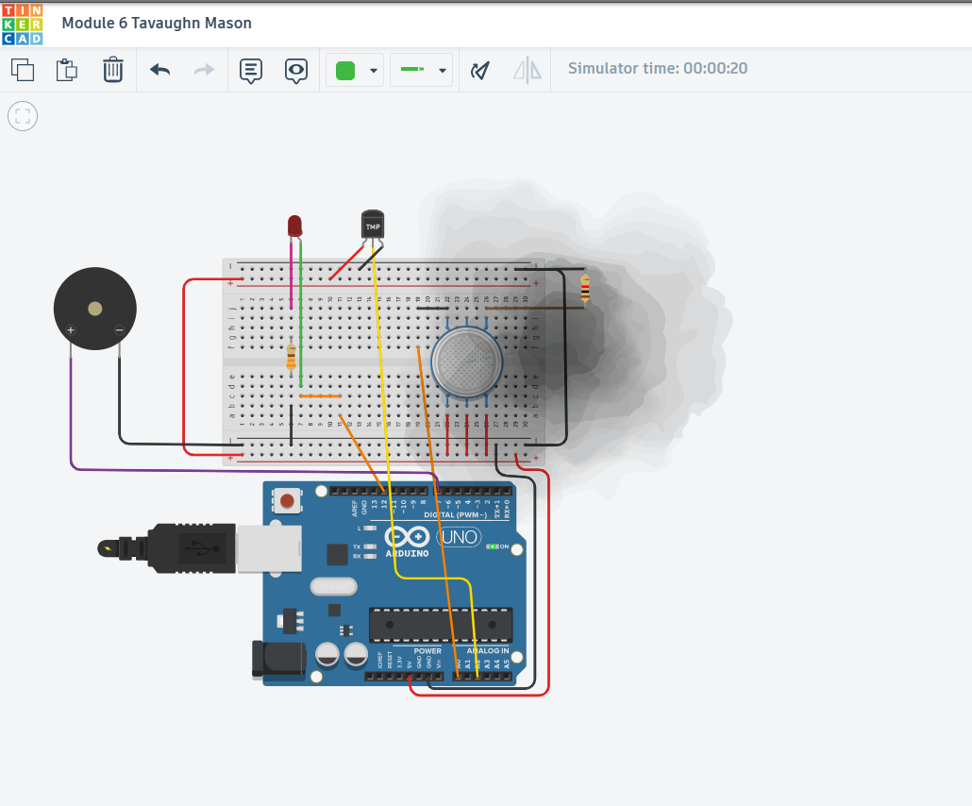
TinkerCad visual of the completed assemply with GAS over the sensor

Slide 24
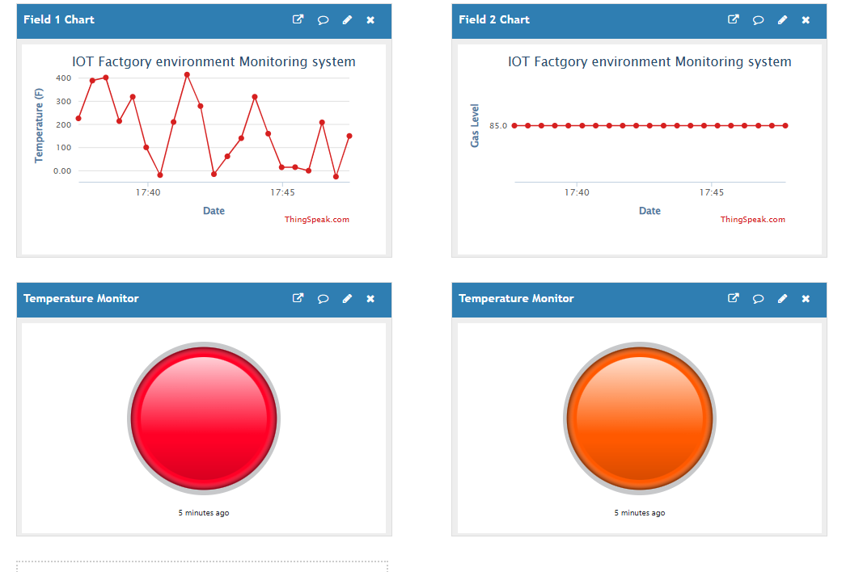
Visual representation of Thingspeak LEDS on showing both the temperature and gas levels

Slide 25
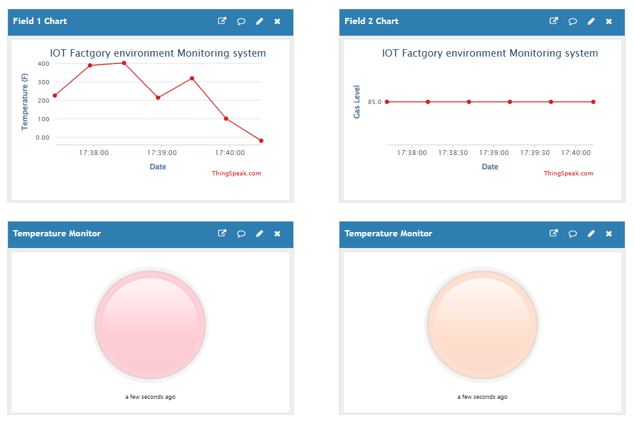
Visual representation of Thing speak LEDs off showing the gas and Temperature sensors

Slide 26
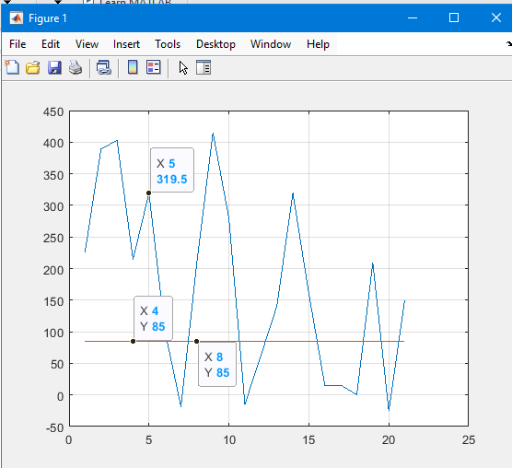
MATLAB data charted for visual clarity

Slide 27

Challenges:
One minor challenge in learning was MATLAB and getting accustomed to its syntax and matrix-based operations, which felt unfamiliar for beginners used to traditional programming languages like Python or C++. MATLAB’s emphasis on matrix manipulation and its unique indexing can initially cause confusion when writing scripts or handling data.
Career Skills:
This course teaches students how to manage and gather data from industrial systems. It covers how factory equipment and other assets connect to IT systems and the internet. Students will learn about PLCs, controllers, IoT setup, communication standards like MODBUS, and IoT system management. The course explores examples from transportation, energy, and manufacturing industries.
Conclusion:
After completing the course, I feel more confident in my skills and understanding of Industrial IoT implementation and its various techniques. I have gained greater knowledge of concepts like digital twins, predictive maintenance, and industrial connectivity.

Slide 28
References
Veneri,G., & Capasso, A (2018). Hands-on industrial Internet of Things. Pactk Publishing

