Slide 1
Smart Home Automation and Security
CEIS101 Final Course Project
Tavaughn Mason
Prof. Reginald Marshal

Slide 2
Introduction
To create a Circuit simulating a Door sensor using an open and close LED light
A circuit with a distance sensor to for added security when an object comes into nominal range
A circuit with a light sensor to turn on when light has been removed from the perimeter
Tools used in this project
  Arduino Mega 2560
  Breadboard
  Resistor 10kΩ
  LEDs
  Ultrasonic Sensor
  Active Buzzer
  Photoresistor
  Wires
  USB Type B cable

Slide 3
Circuit Simulation in TinkerCAD

Slide 4
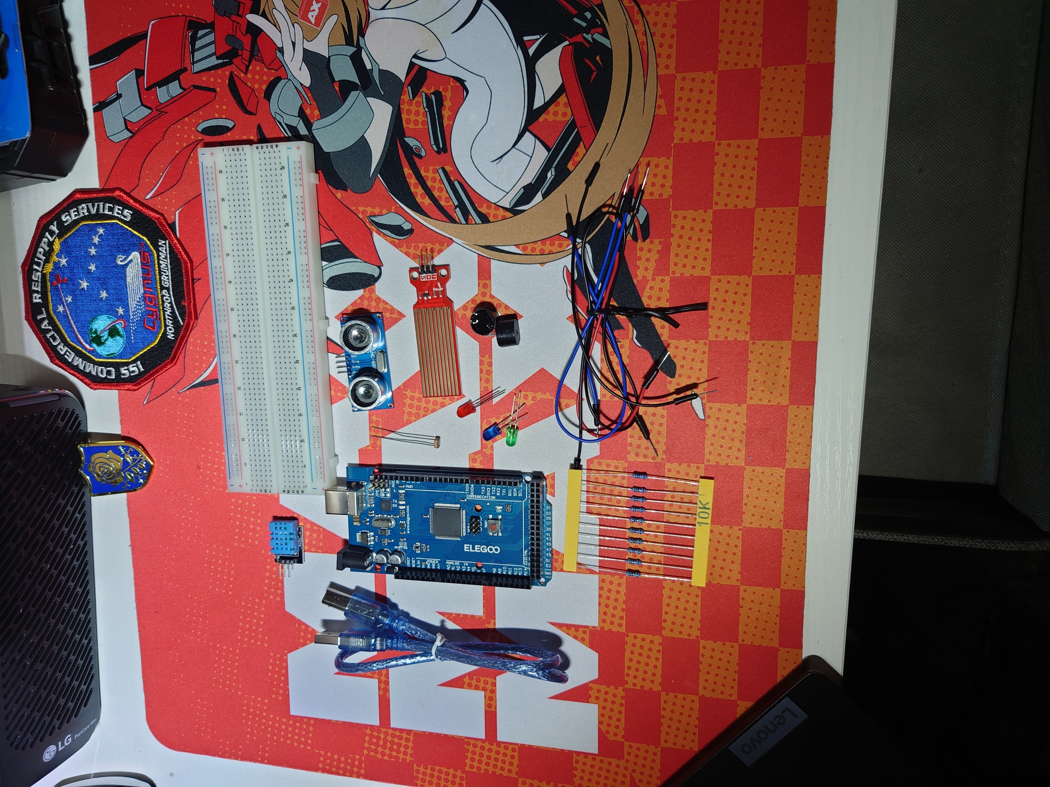
Inventory of Iot Kit
  Arduino Mega 2560
  Breadboard
  Resistor 10kΩ
  LEDs
  Ultrasonic Sensor
  Active Buzzer
  Photoresistor
  Wires
  USB Type B cable

Slide 5
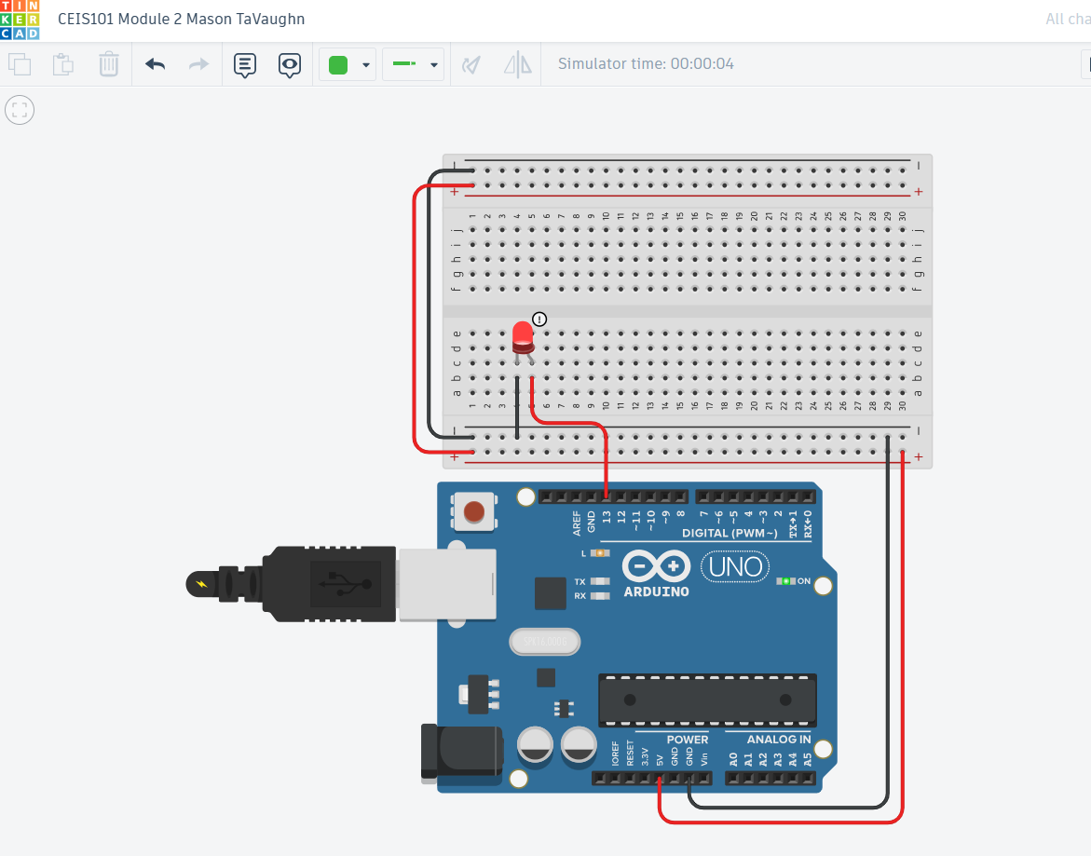
Building a Circuit

Slide 6
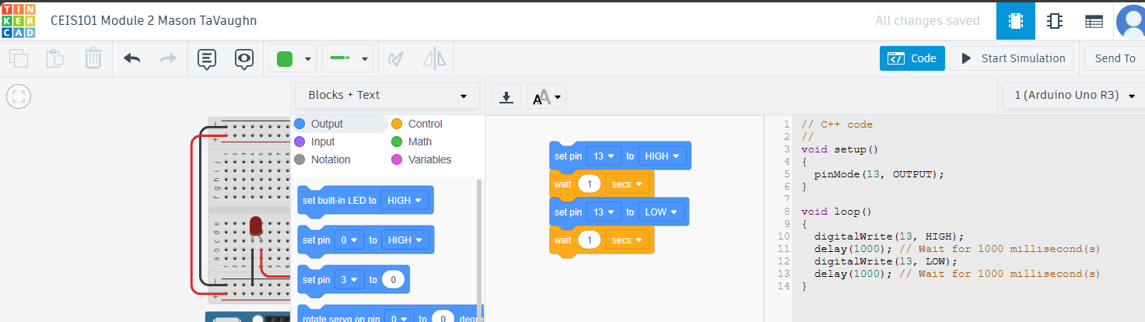
Screenshot of code from Tinkercad

Slide 7
Circuit Building, Inventory of parts and Displaying Messages

Slide 8
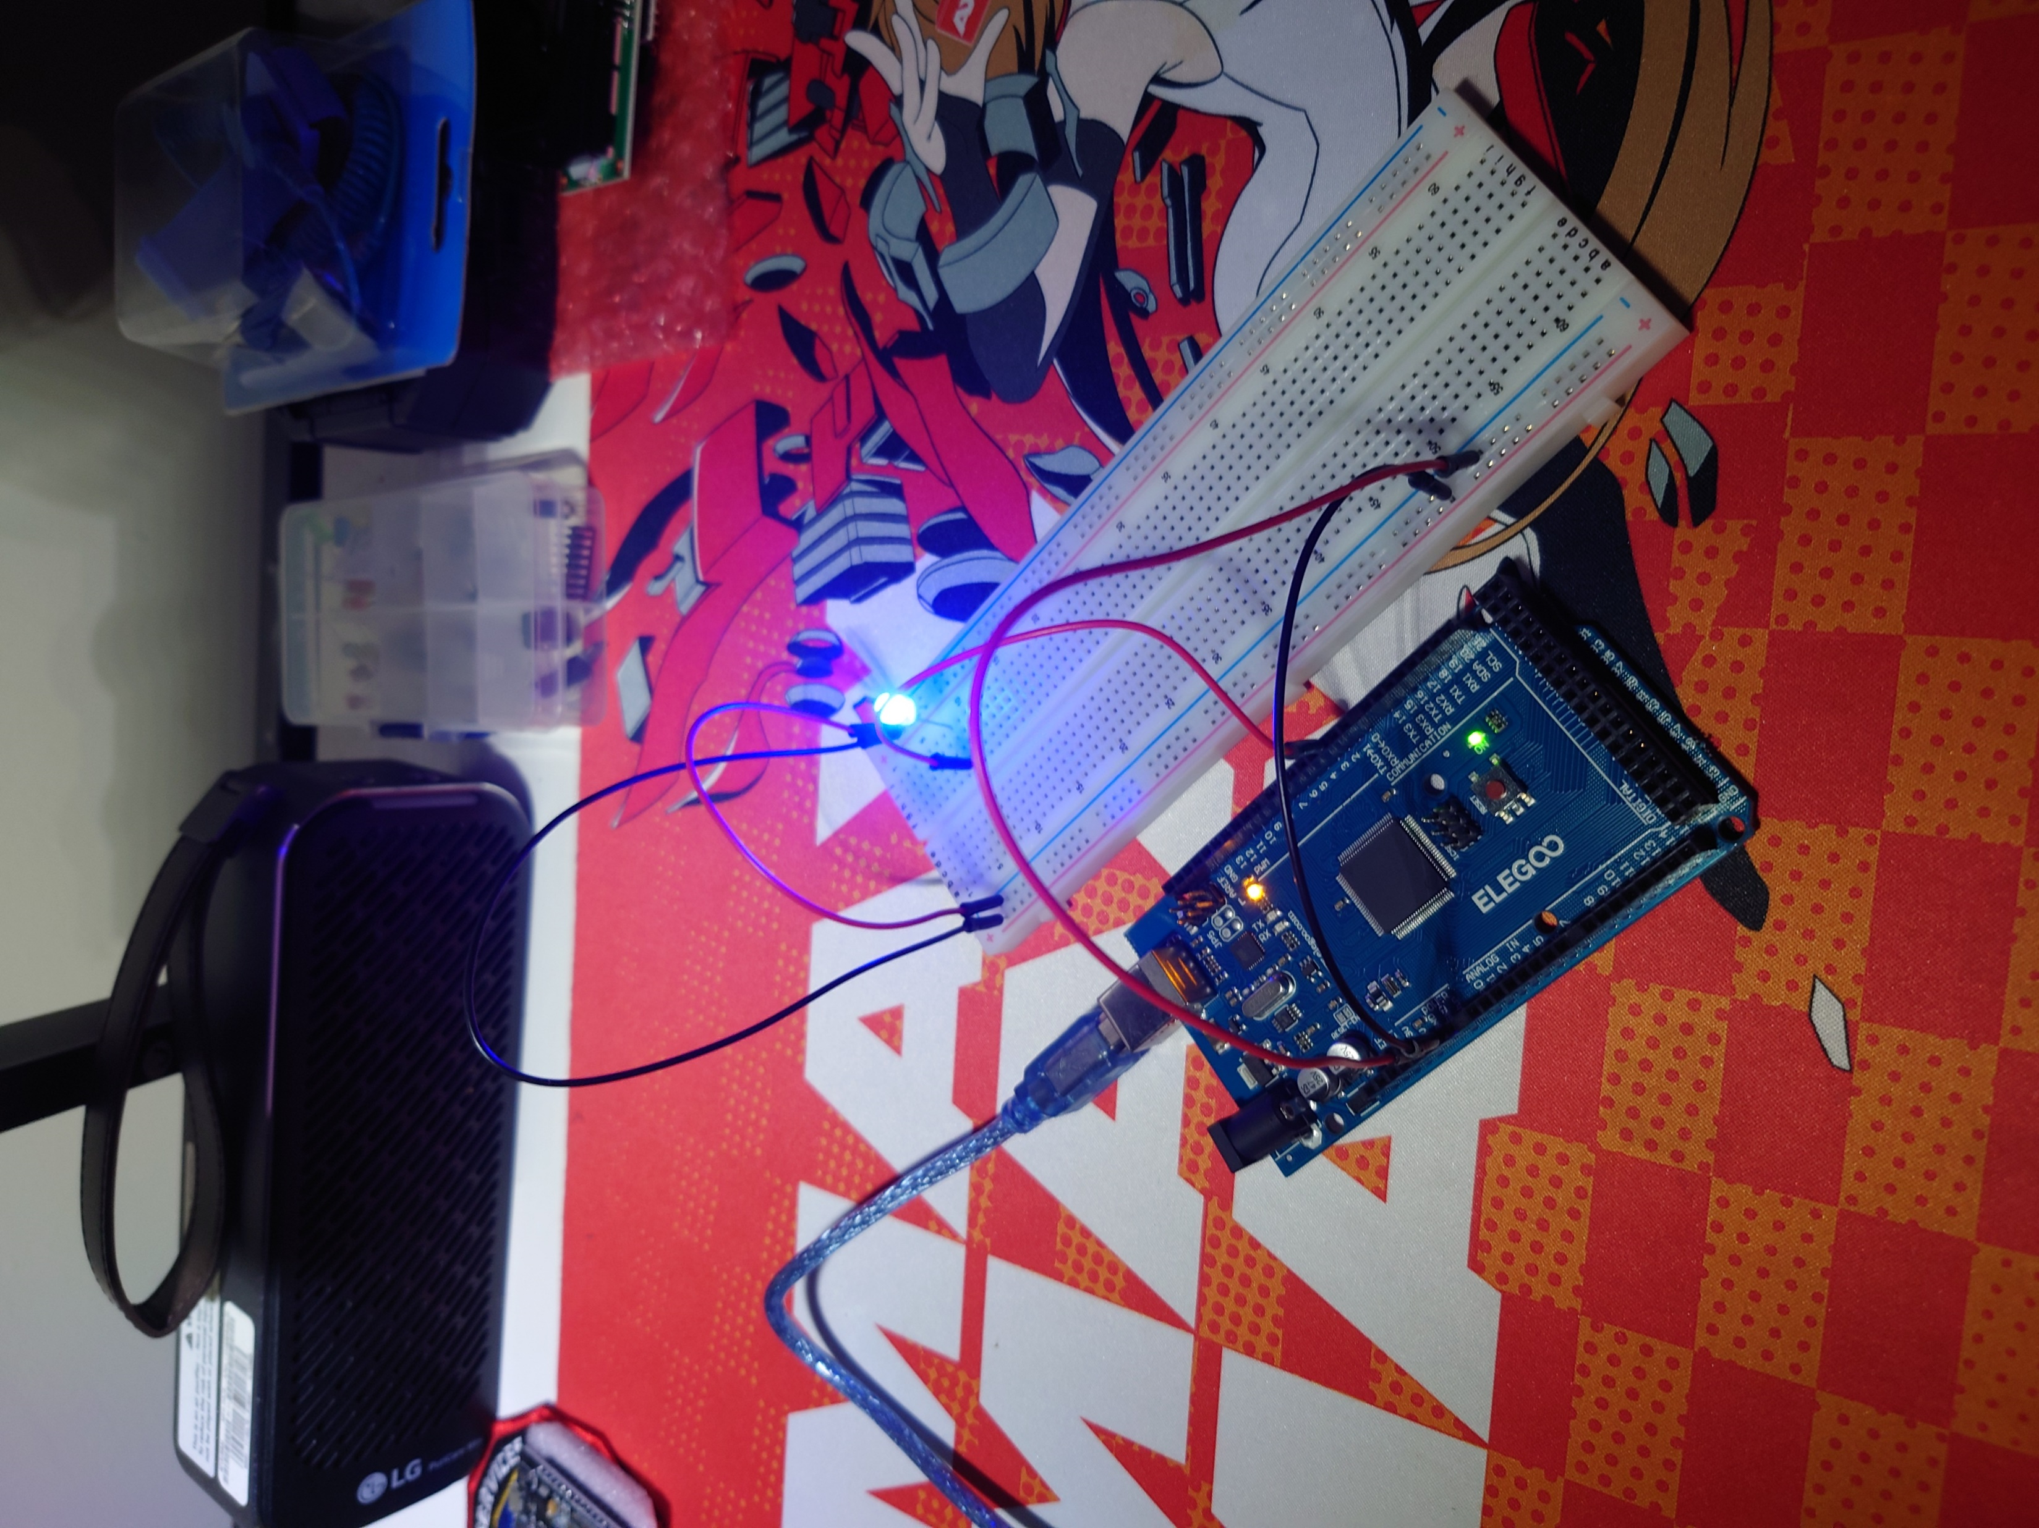
Circuit with LED On

Slide 9
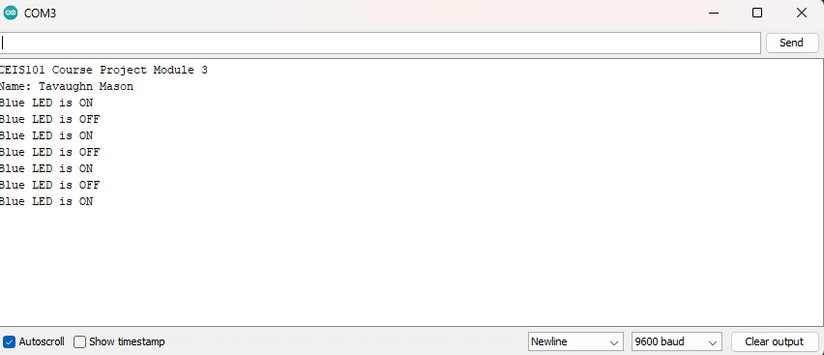
Serial Monitor

Slide 10
Adding Door Sensor to Smart Home

Slide 11
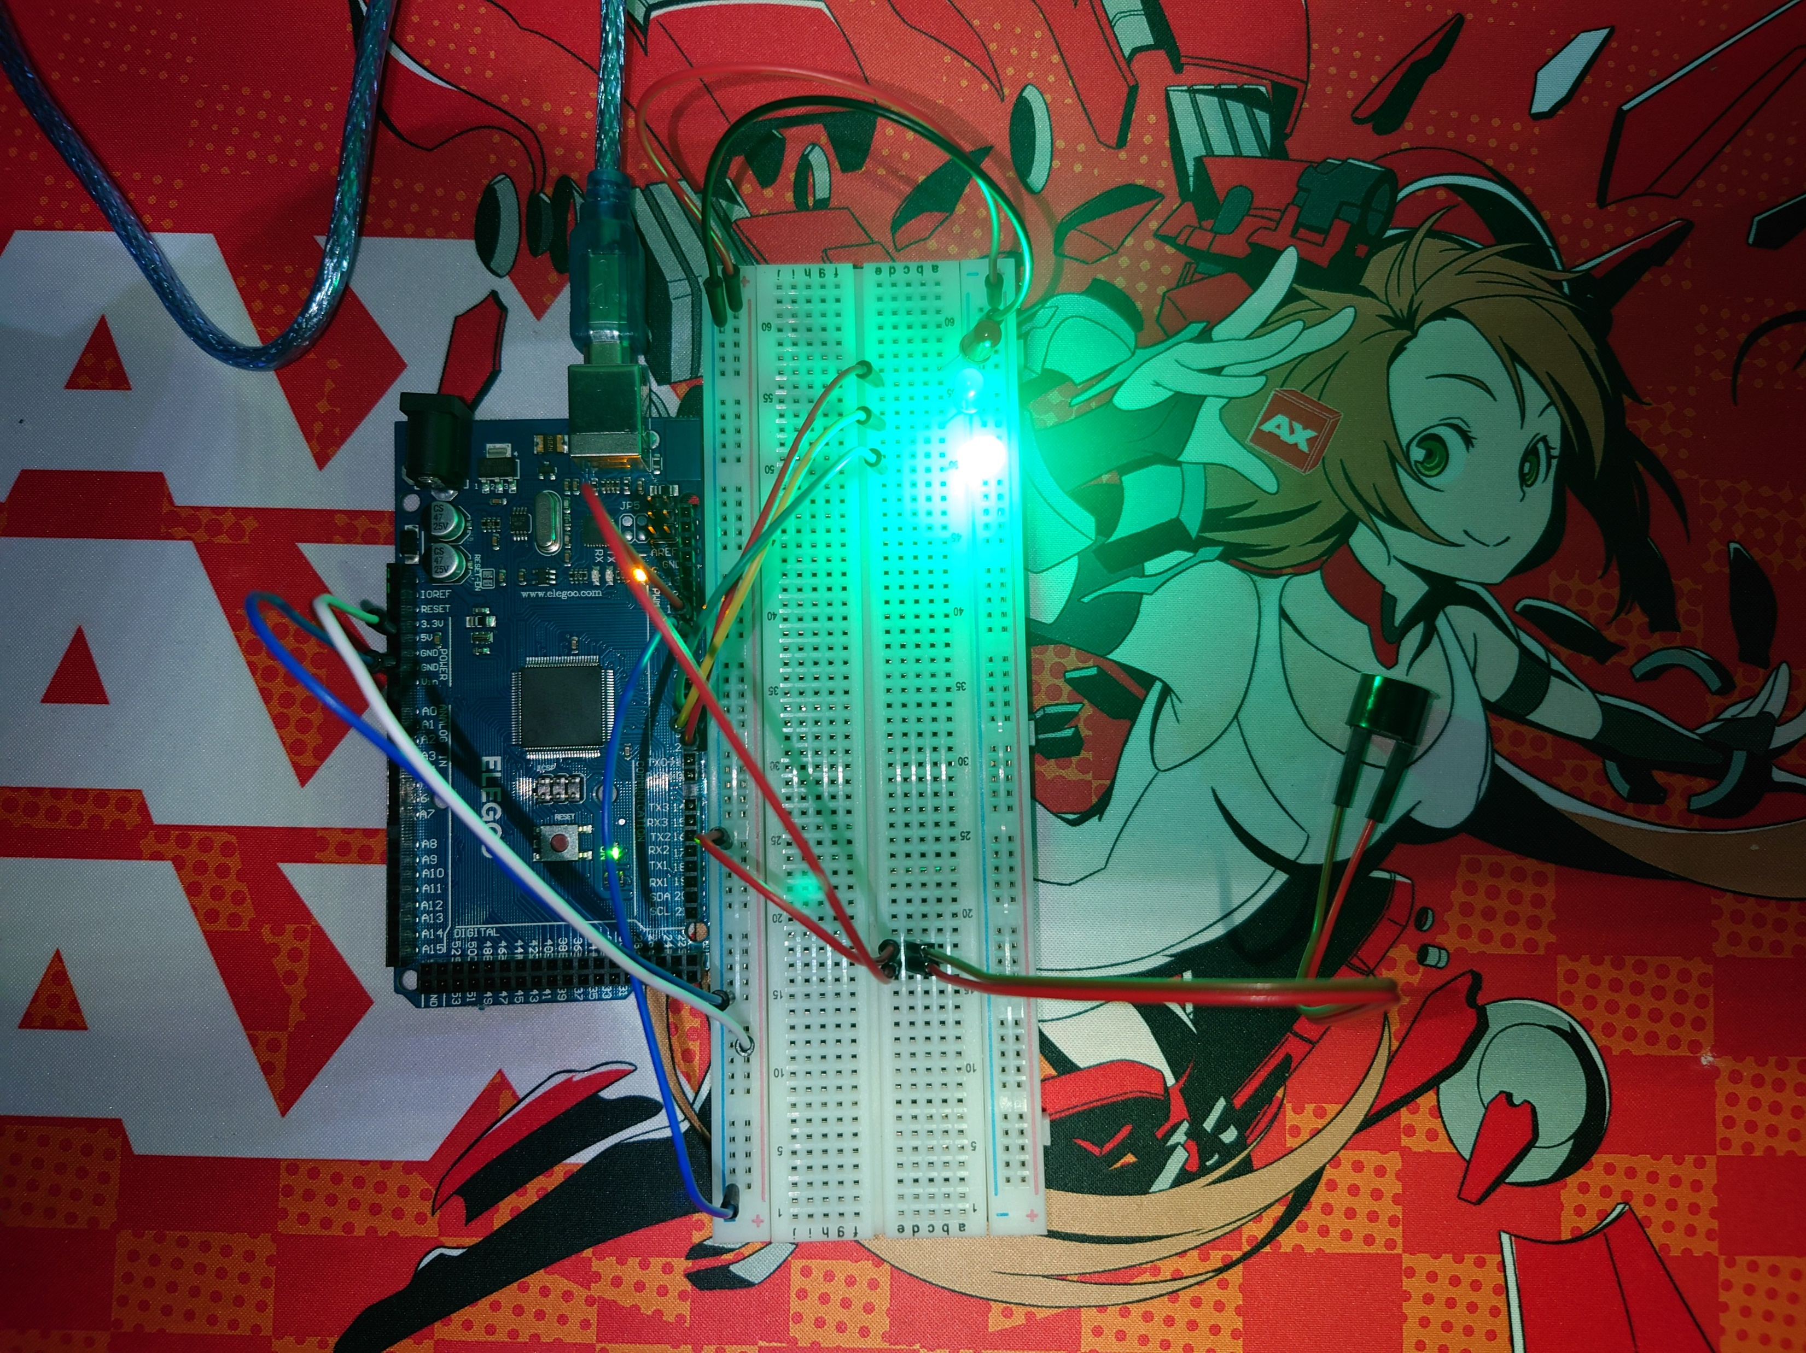
Circuit with door closed and LED on

Slide 12
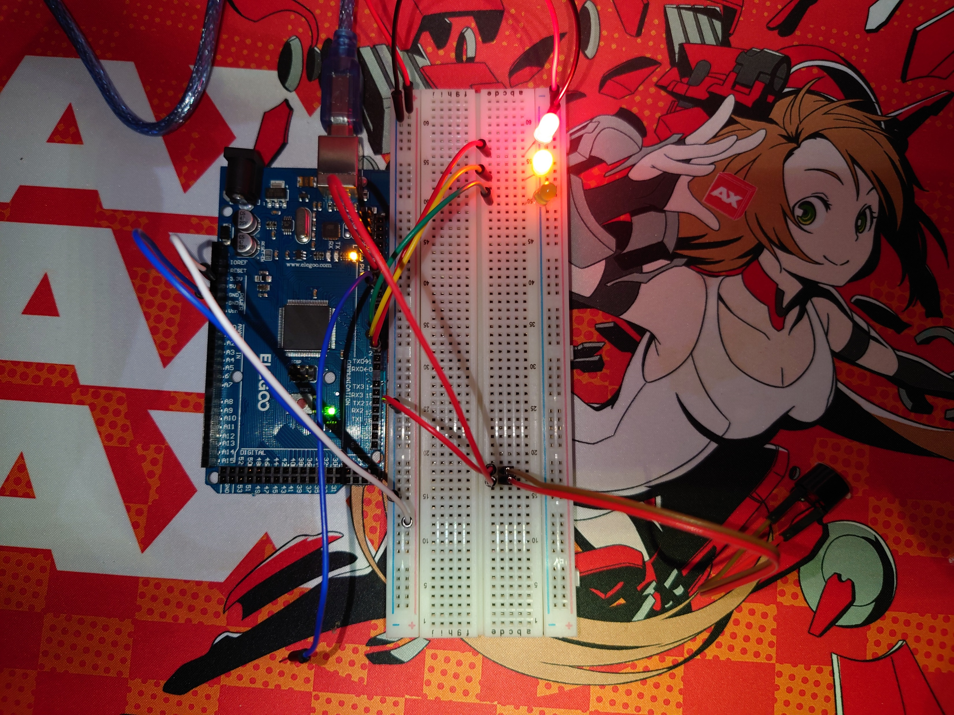
Circuit with door open and green LED off

Slide 13
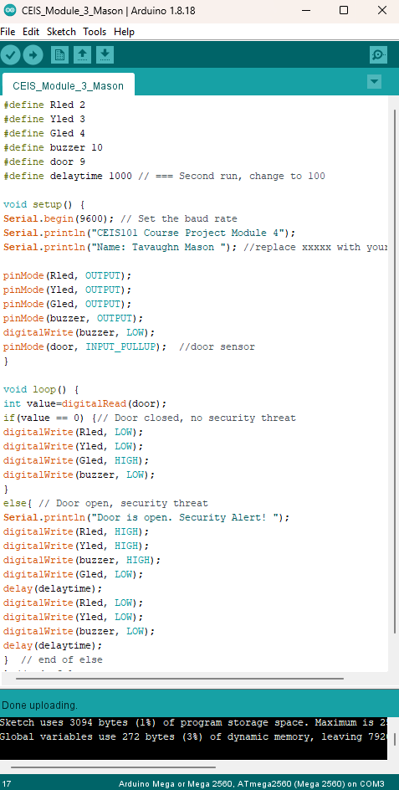
Arduino Code

Slide 14
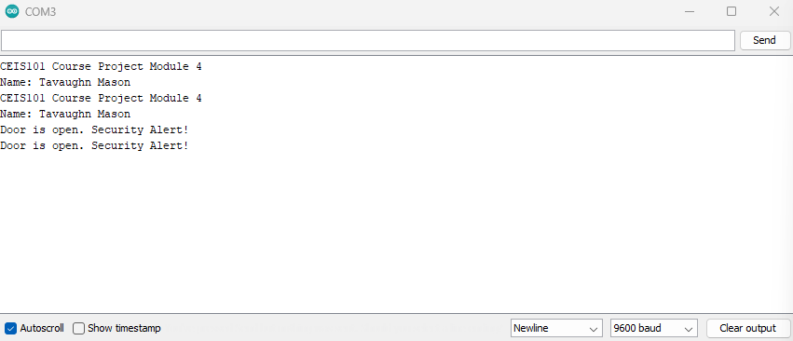
Serial Monitor for Arduino

Slide 15
Adding Distance Sensor to Smart Home System
Conducting Data Analysis

Slide 16
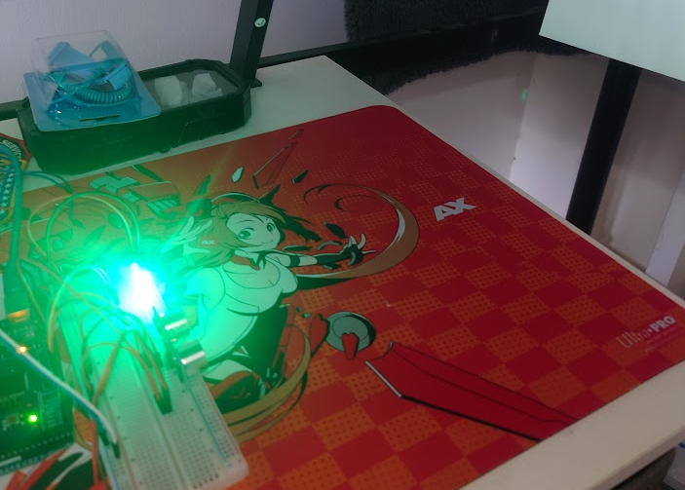
Circuit with green LED and distance captured

Slide 17
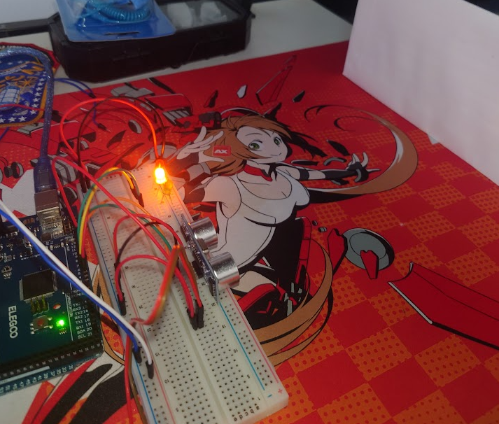
Circuit with yellow On and Distance captured (Near)

Slide 18
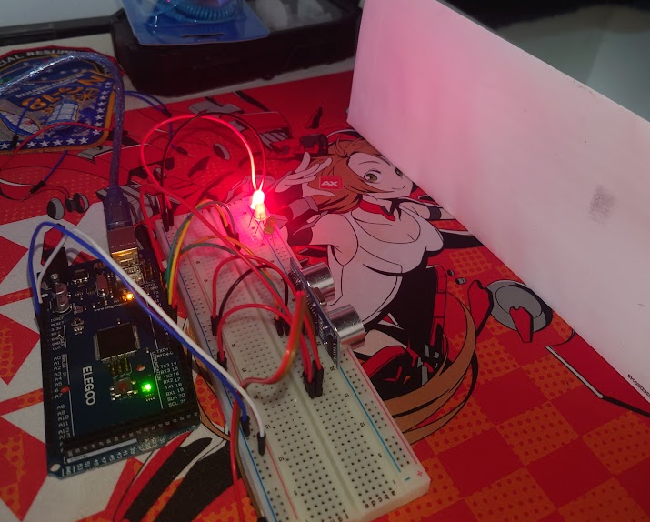
Circuit with Red LED and Distance captured
(Closest)

Slide 19
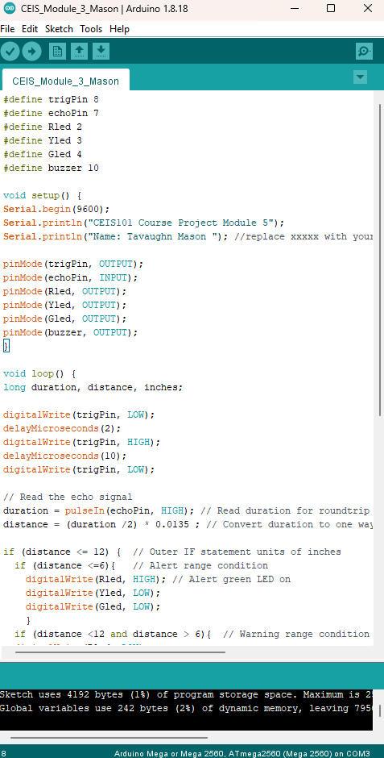
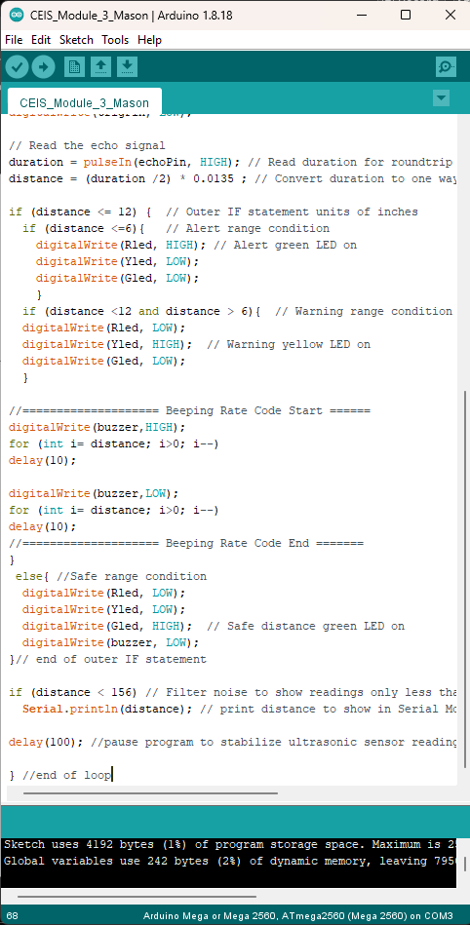
Arduino Distance Code

Slide 20
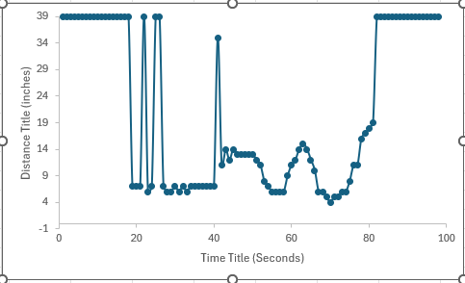
Plot of data using Excel Spreadsheet

Slide 21
Adding Automated Light to Smart Home

Slide 22
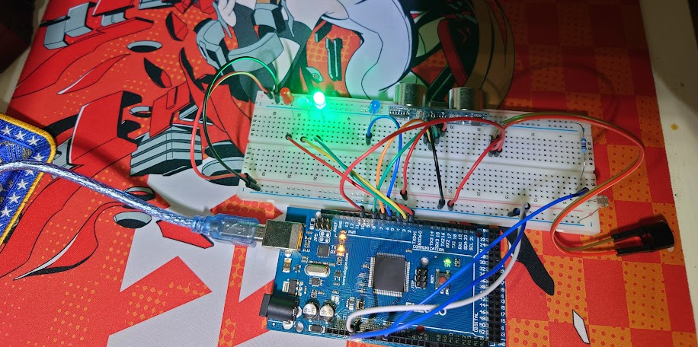
Circuit with Automated light LED off

Slide 23
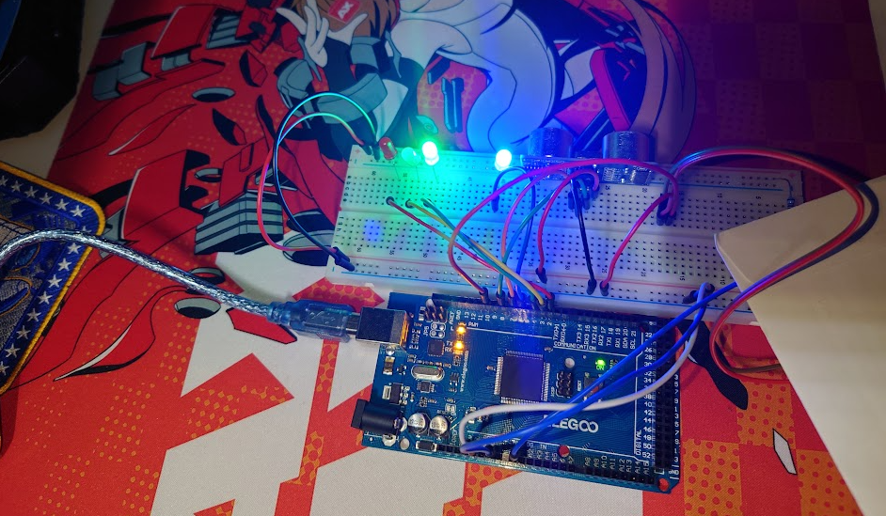
Circuit with Automated light LED on

Slide 24
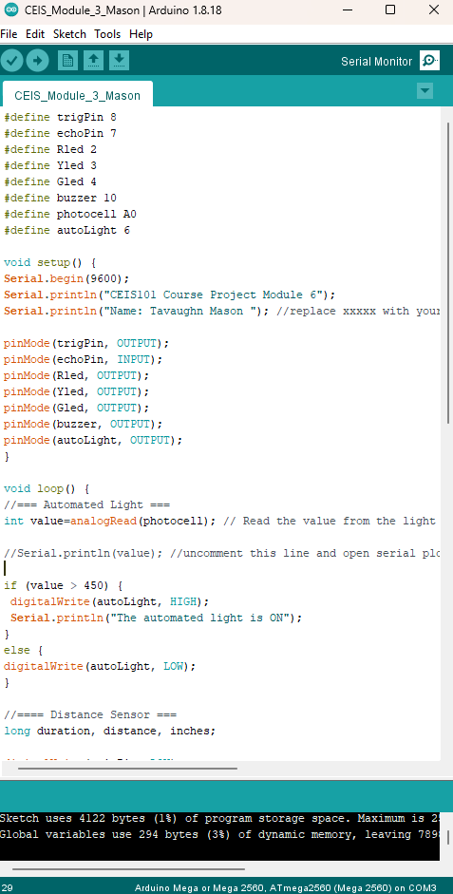
Arduino Code

Slide 25
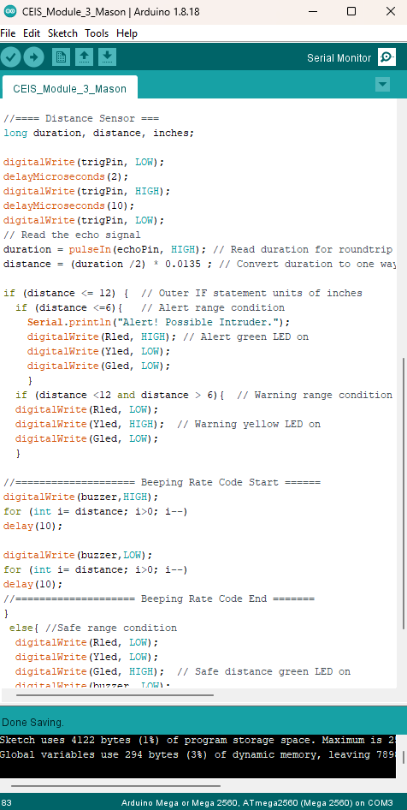
Arduino code
(Continued)

Slide 26
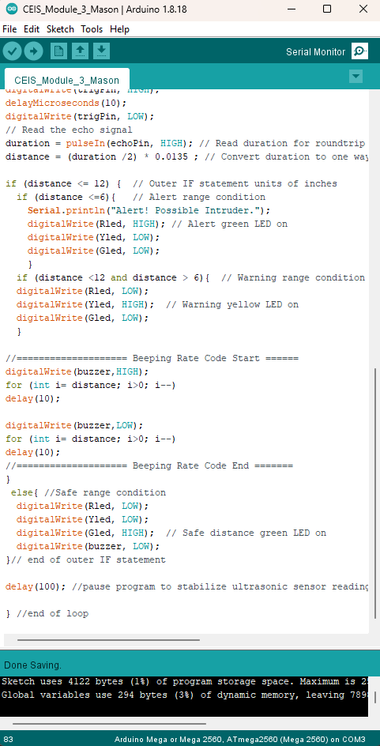
Arduino Code
(Continued)

Slide 27
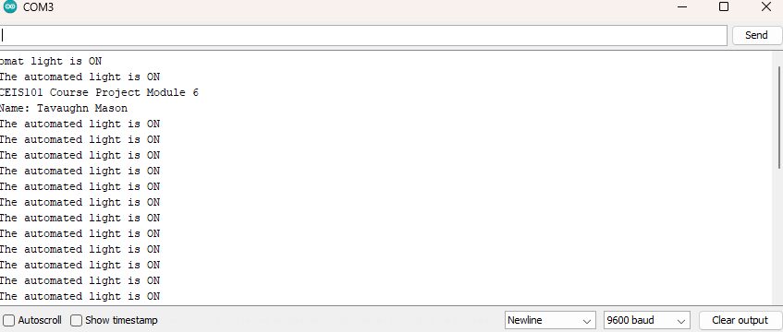
Serial Monitor for Automated Light LED

Slide 28
Challenges/Lessons Learned
A common challenge I noticed during the build was the incorrect placement of component Leds in relation to its PWR and RTN signal. Another challenge was contextual information on the wrong baud rate when viewing the serial plotter
I overcame the issue with the Leds by referring to the technical documentation supplied with the project build and component supply to determine the correct alignment of the Diodes for placement on the breadboard. The baud rate on the serial plotter was addressed by reviewing the inputted code, selecting the baud rate plotter, and matching it with the serial plotter during system operation
Carefully reviewing the documentation ahead of time can help reduce the cost and time it takes to build the project since the incorrect placement of an LED can indirectly damage the component beyond normal repair methods. An Incorrect Baud rate can have you lost without information to accurately show you the running systems after the code application

Slide 29
Career Skills
The basic skills developed in this Course involve document and drawing reading, a Minor understanding of visual logic diagrams and wiring, and level coding interrogation and implementation
The competencies that helped me develop and advance my career is the entry-level understating of how the code is directly related to its physical pinouts in a simple form. It also allowed me to test and reassign signals to other pin locations while directly monitoring the information through a serial monitor.

Slide 30
Conclusion
During my journey of this course I grasped a basic understanding of how IOT is used and defined at a basic level. Its importance in how it pertains to connecting people to devices across the world. I gained a solid understanding of how simple coding methods are used in this course and the many techniques required to troubleshoot devices and build small circuits of varying product request.

Slide 31
References
TinkerCad
DeVry student project guide
Engageli Live Orientation

